Slide 1
Fiscal Sustainability after Covid-19:
Rethinking of Domar Condition
Naoyuki YOSHINO
Professor Emeritus of Keio University
Former Dean&CEO, ADBI
yoshino@econ.keio.ac.jp
Hiroaki MIYAMOTO
Professor Tokyo Metropolitan University

Slide 3
Domar Condition of Fiscal Stability
Interest Rate (r_{t}) > growth rate of the economy(η) → Unstable
Interest Rate (r_{t})< growth rate of the economy(η) → Stable

Slide 4
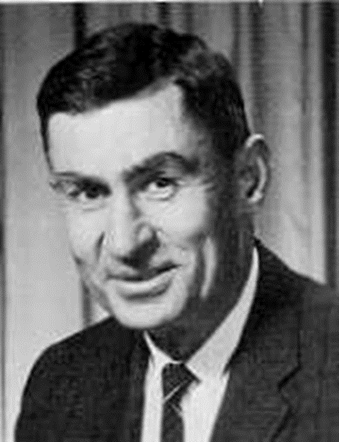
Fiscal Sustainability: Domar condition
Interest rate＜Economic Growth
Debt
explosion
△B
△B
Stable
time
time
r＞g

Slide 5
Revival of Domar Condition
by Paul Krugman and Tirore
Domar condition is obtained only by the supply side of government bonds and does not take into account of demand for government bonds.
US government bonds are purchased by all over the world.

Slide 6
Yoshino-Mizoguchi-Hesary (2019)

Slide 7
Japanese Debt, 92% were held by Domestic Investors
2012
HOLDERS | %
Banks and Postal Savings | 45%
Life and Non-life Insurances | 20%
Public Pension funds | 10%
Private Pension Funds | 4%
Central Bank of Japan | 8%
Overseas’ Investors | 8%
Households | 5%
Others | 3%
Source: MOF

Slide 8
Greece, 80% of their debts were held by overseas’ Investors
(2011)
HOLDERS | ％
Eurozone | 15%
ECB | 15%
IMF | 6%
Greek banks & non-banks | 23%
Other European Banks | 10%
Non European Banks | 8%
Non-Greek non-Banks | 23%

Slide 10
Holdings of Government Bonds in Japan 2013 & 2019

Slide 11
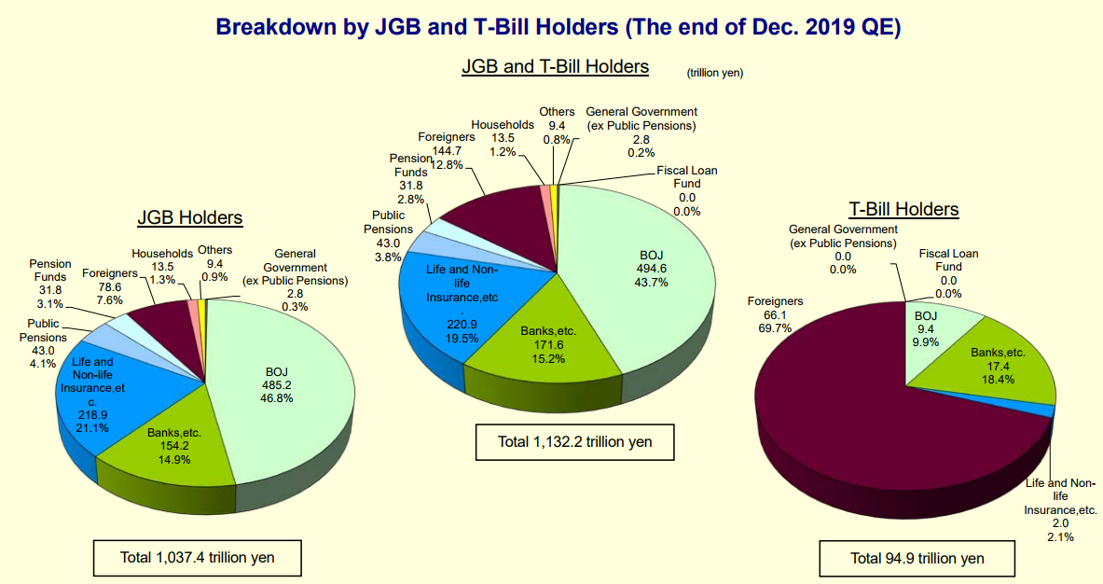

Slide 12
World Bank, Uneven Recovery, April 2021

Slide 13
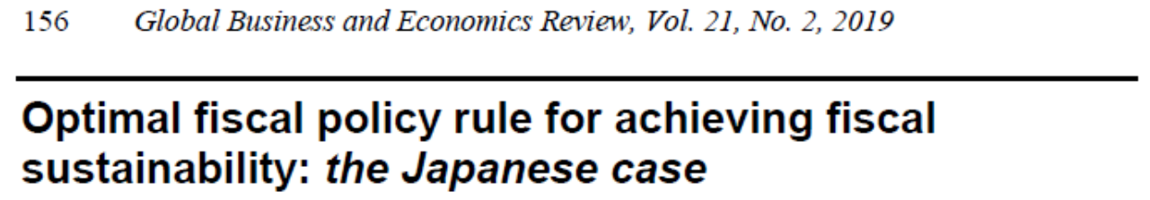


Slide 14
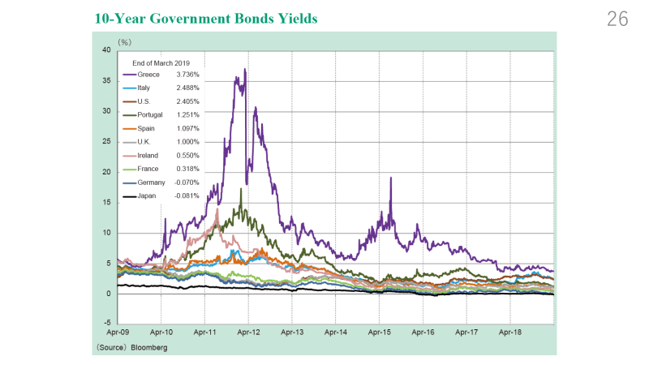

Slide 15
Demand for Government bonds

Slide 16
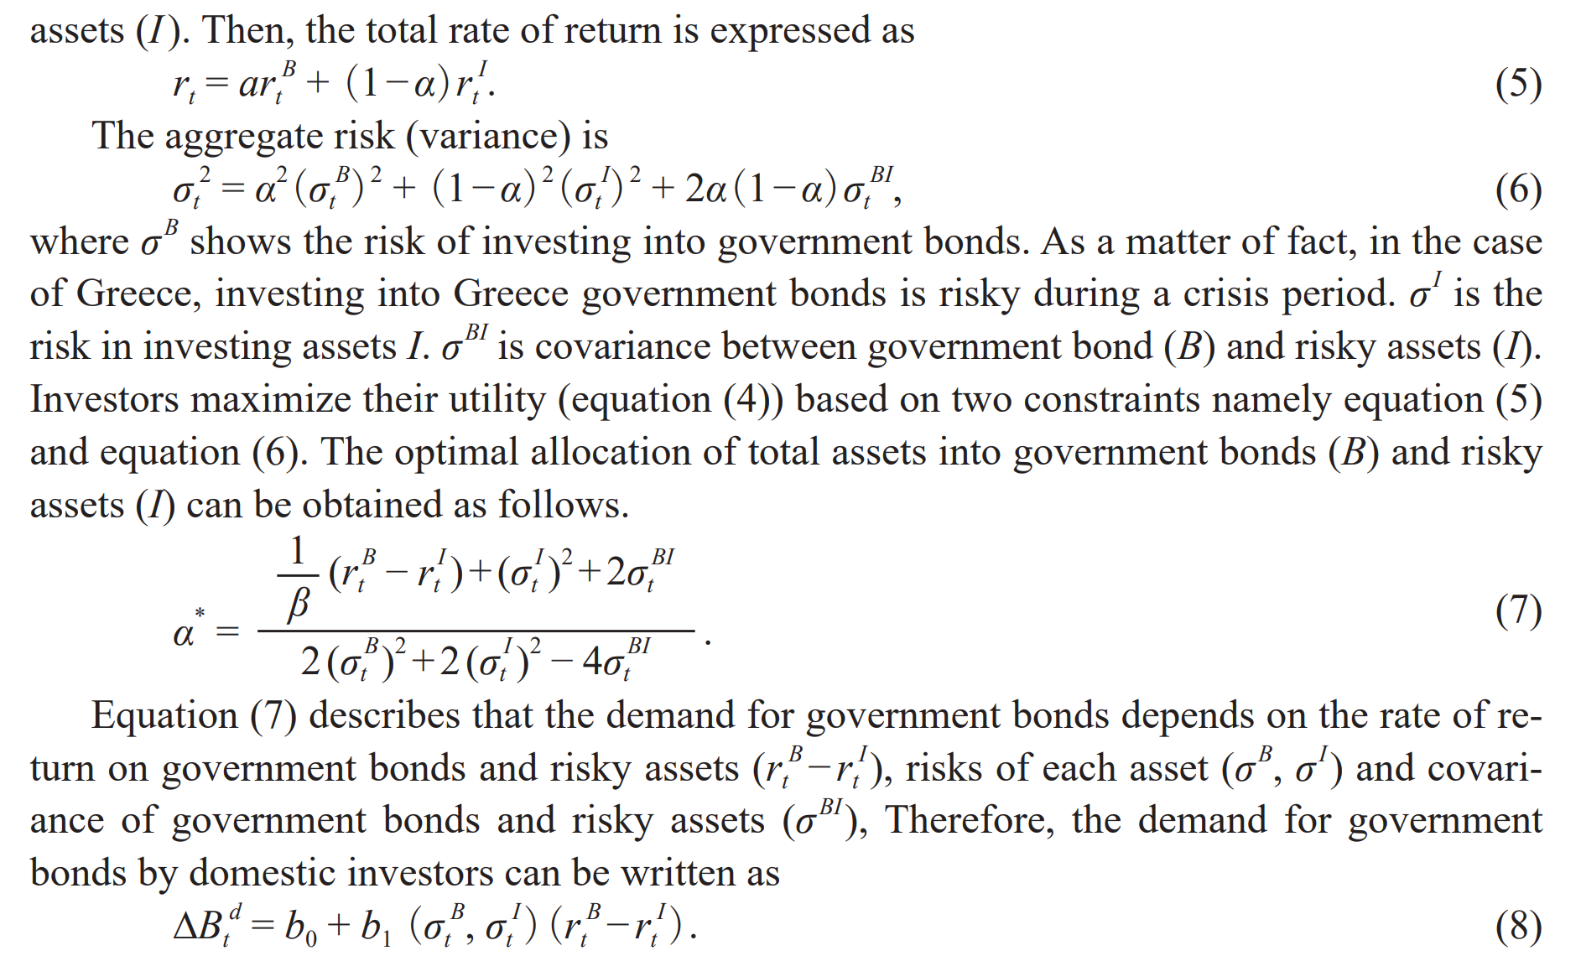

Slide 17
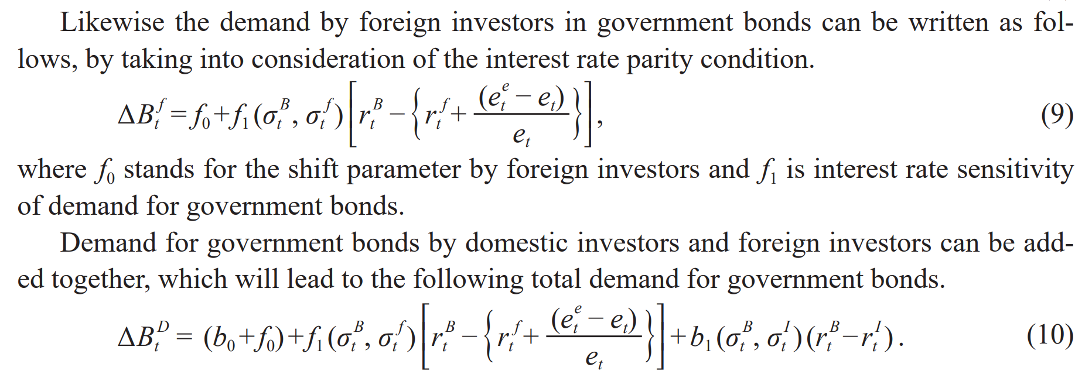

Slide 18
Supply of
Government bonds

Slide 19
Revised Domar Condition
Accumulated
Bonds
<
Interest rate
Sensitivity
Of demand

Slide 20
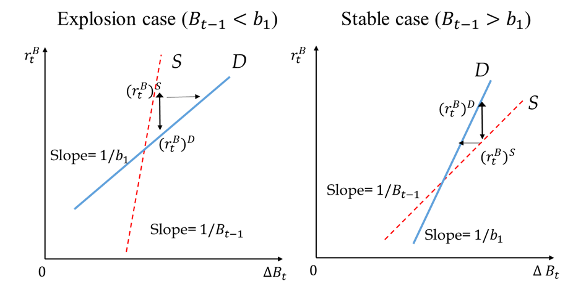


Revised Budget Stability Condition
1
0
3
4

Slide 21
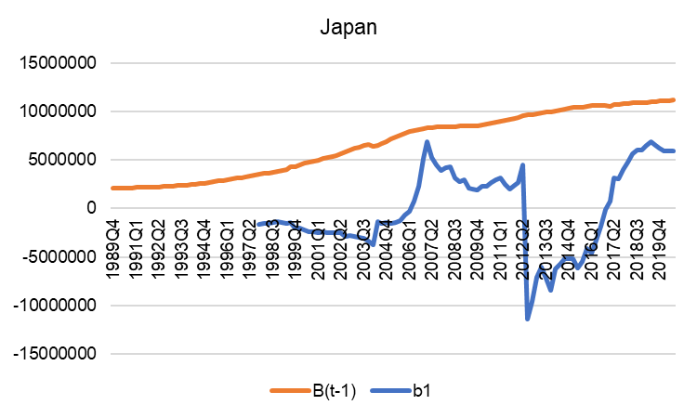
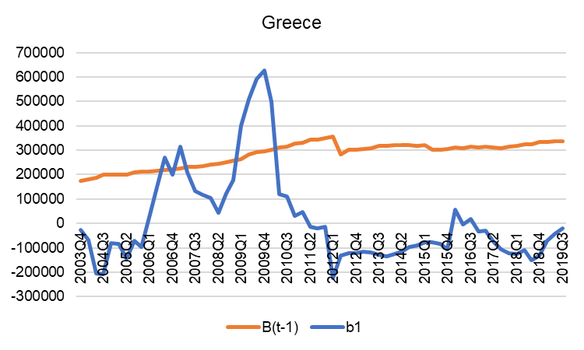
Comparison between Greece and Japan
Global Solutions Journal (2020)

Slide 22
Stability
Condition
Including
Foreign
Investors

Slide 23
The following equation shows the adjustment speed of the government bond market adding domestic investors and overseas’ investors as a whole.
（dα/ｄｔ）＝（dα_{d}）（D/(D+F)）＋（dα_{F}）（F/（D+F））
Where dα=Movement speed of total government bond
dα_{d}=Movement speed of domestic investors
ｄα_{F}=Movement speed of foreign investors
D/(D+F) = Share of domestic investors
F/(D+F) =Share of foreign investors

Slide 24
Application to
Central and Local Government
Central Government Bond Market
Gc + r x Bc + TRN = ΔBc + ΔTc +ΔM Supply
Demand for Central Government Bonds
Local Government Bond Market
G_{L} + r x B_{L} = ΔB_{L}＋ΔT_{L} + TRN + NTR Supply
Demand for Local Government Bonds

Slide 25
Stability Condition for Local Government
δrL* = -(-G+TRN+NTR+T_{L}+b₀-b₁r^{I}+b₂σ_{I}） = -rL* > 0
δB_{t-1} (B_{t-1}^{ℒ}－b₁)² (B_{t-1}^{L}－b₁) <
If B_{t-1}^{L}－b₁ <0 → Unstable
If B_{t-1}^{L}－b₁ >0 → Stable
δΔBL＊ ＝rL* x (-b₁) > 0 (B_{t-1}^{L}－b₁) <0 Diverge
δB_{t-1}^{L} (B_{t-1}^{L}－b₁) < (B_{t-1}^{L}－b₁) >0 Converge
Demand Sensitivity < Stock of Bonds → Stable
(Demand side is willing to pay high interest rate)

Slide 26
Yoshino, Mizoguchi and Taghizadeh-Hesary (2019). “Optimal fiscal policy rule for achieving fiscal sustainability: the Japanese case”, Global Business and Economics Review, Vol.21, No.2, pp.156.
Yoshino and Miyamoto (2020) Forthcoming “Revisit Public Debt Stability Condition: Rethinking of the Domar Condition after COVID-19”, Global Solutions Journal, Germany.

