Slide 1
Modelling Household Debt OverhangConditions
YOSHINO-Naoyuki/Professor Emeritus/ Keio University / Japan
Adjunct Professor at GRIPS
Former Dean and CEO, ADBI
Prachi Gupta, Former RA of ADBI

Slide 2
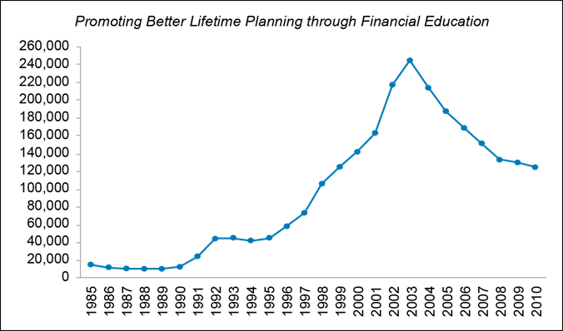
Lessons from Japan

Slide 3
Household debt level in South Korea and US
South Korea: HH debt to disposable income (%)
US: HH debt to disposable income (%)

Slide 4
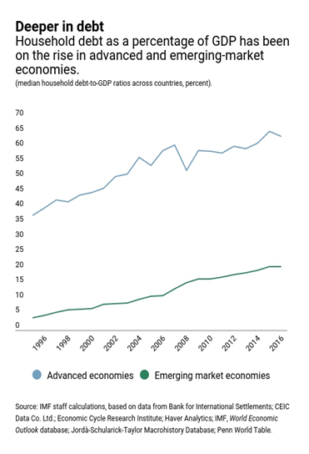
Advanced and emerging market economies
Advanced economies
Emerging market economies

Slide 5
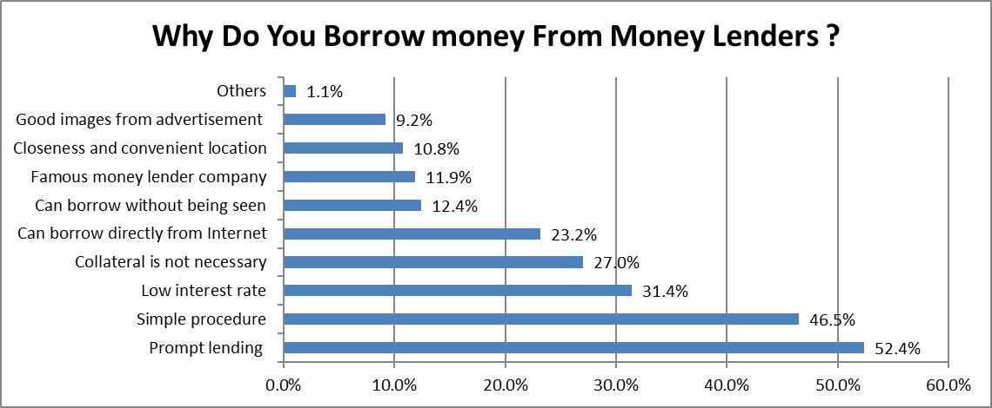

Slide 6
Theoretical Model

Slide 7
1, L₀/Y₀ = [ Initial Loan/Income] ratio
2, r = Interest Rate
3, n = number of years of borrowing
4, a = growth rate of income
5, c = marginal propensity to consume

Slide 8

Loan/Income Ratio of Japan
LOAN
＝INCOME
Maturity
Interest Rate
ＭＰＣ=0.70, Income Growth=1.6%

Slide 9
a. Ceiling on borrowing ratio: L/Y=1/3
Interest rate ceiling: 20%
Borrowers’ information: The law required all individual borrowing within a household to be aggregated to obtain the total household borrowing
Self-regulatory association of money lenders: A self-regulatory association of moneylenders
Consumer care hotline:

Slide 10
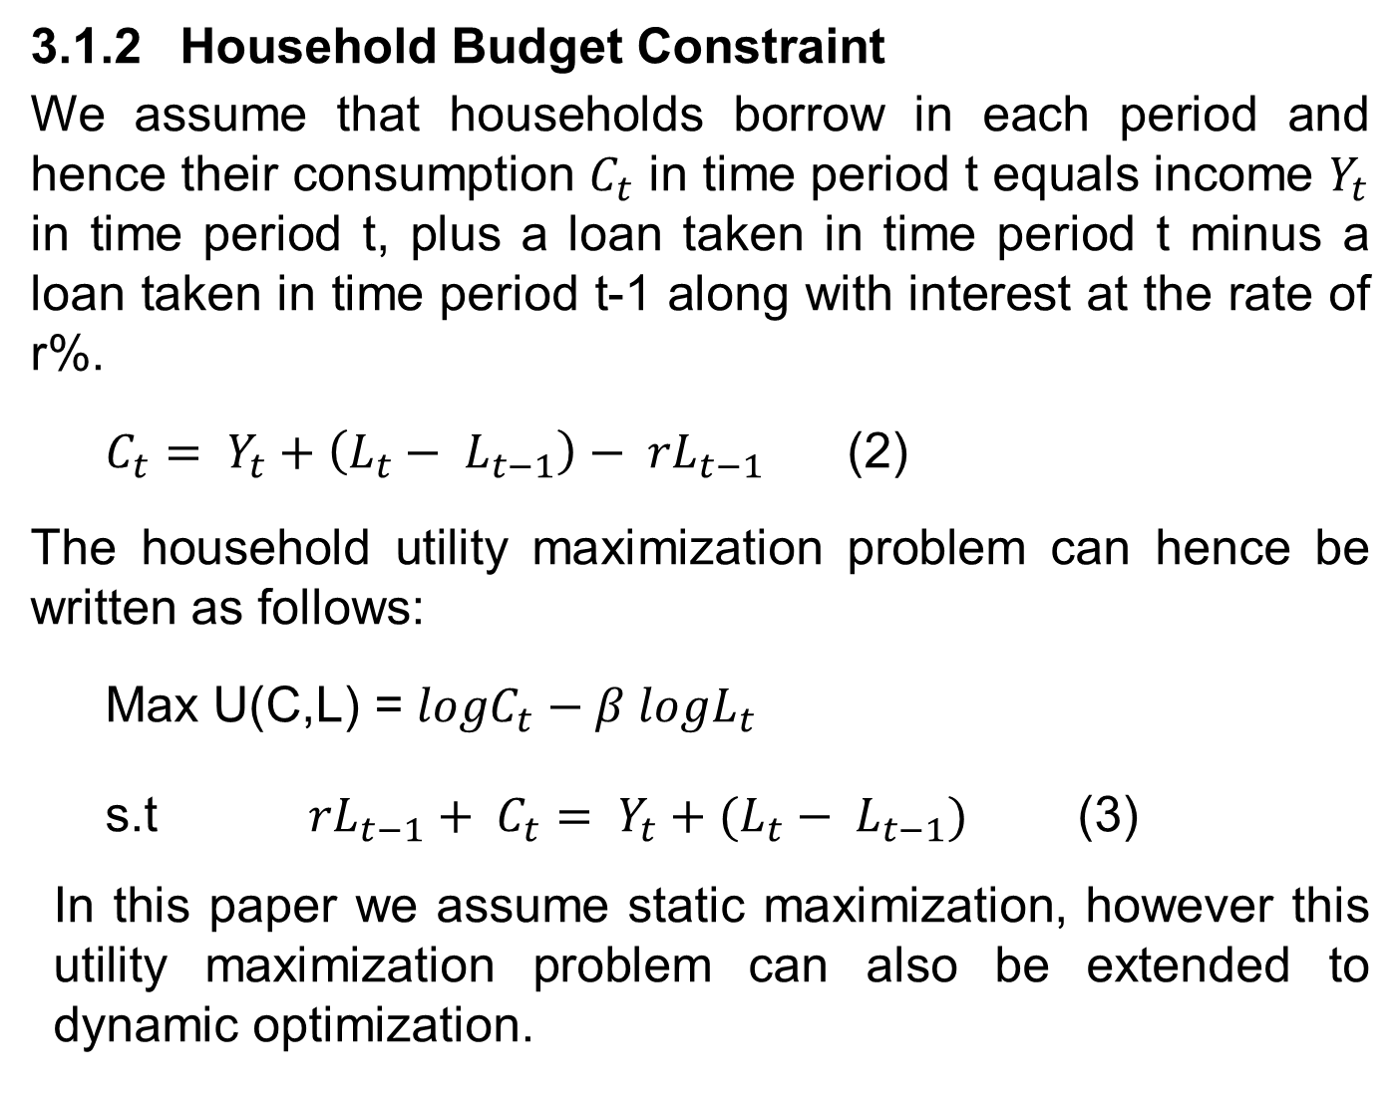
3.1.2 Household Budget Constraint
We assume that households borrow in each period and hence their consumption $C_{t}$ in time period t equals income $Y_{t}$ in time period t, plus a loan taken in time period t minus a loan taken in time period t-1 along with interest at the rate of r%.
$C_{t}= Y_{t}+\left(L_{t}− L_{t−1}\right)− {rL}_{t−1}$ (2)
The household utility maximization problem can hence be written as follows:
Max U(C,L) = $logC_{t}−β logL_{t}$
s.t ${rL}_{t−1}+ C_{t}= Y_{t}+(L_{t}− L_{t−1})$ (3)
In this paper we assume static maximization, however this utility maximization problem can also be extended to dynamic optimization.

Slide 11
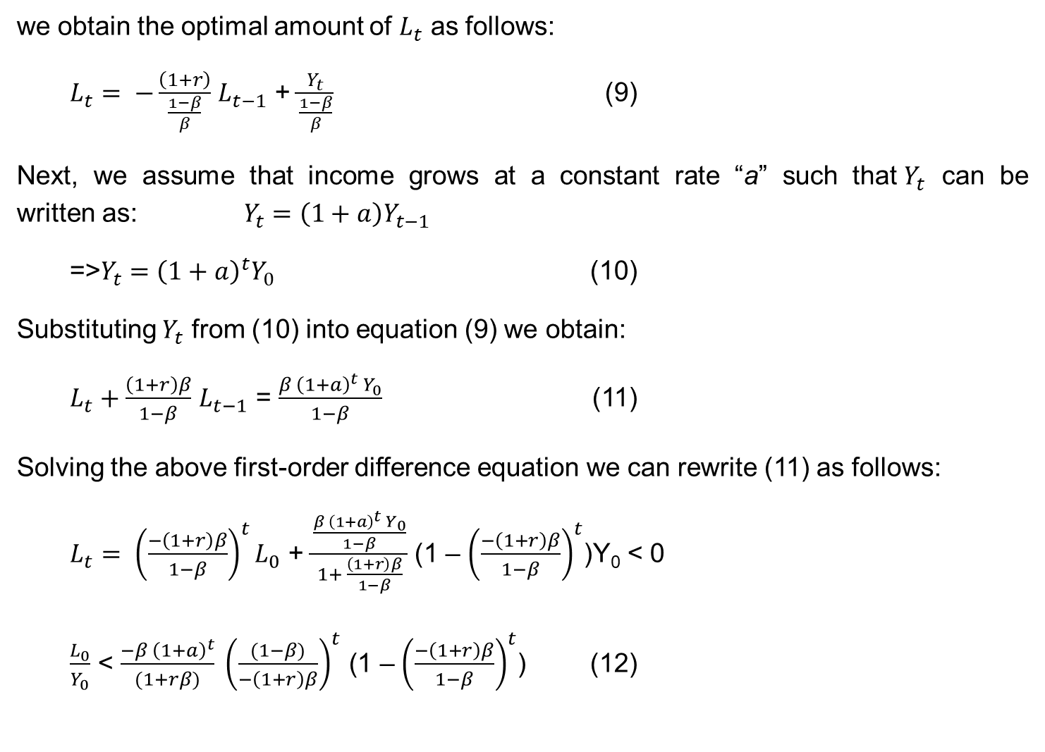
we obtain the optimal amount of $L_{t}$ as follows:
$L_{t}= −\frac{\left(1+r\right)}{\frac{1−β}{β}}$ $L_{t−1}$ + $\frac{Y_{t}}{\frac{1−β}{β}}$ (9)
Next, we assume that income grows at a constant rate “a” such that$Y_{t}$ can be
written as: $Y_{t}=\left(1+a\right)Y_{t−1}$
=>$Y_{t}={\left(1+a\right)}^{t}Y_{0}$ (10)
Substituting $Y_{t}$ from (10) into equation (9) we obtain:
$L_{t}+\frac{\left(1+r\right)β}{1−β}$ $L_{t−1}$ = $\frac{β {\left(1+a\right)}^{t}{ Y}_{0}}{1−β}$ (11)
Solving the above first-order difference equation we can rewrite (11) as follows:
$L_{t}= {\left(\frac{−\left(1+r\right)β}{1−β}\right)}^{t}L_{0}$ + $\frac{\frac{β {\left(1+a\right)}^{t}{ Y}_{0}}{1−β}}{1+ \frac{\left(1+r\right)β}{1−β}}$ (1 – ${\left(\frac{−\left(1+r\right)β}{1−β}\right)}^{t}$)Y₀ < 0
$\frac{L_{0}}{Y_{0}}$ < $\frac{−β {\left(1+a\right)}^{t}}{(1+rβ)} {\left(\frac{(1−β)}{−\left(1+r\right)β}\right)}^{t}$ (1 – ${\left(\frac{−\left(1+r\right)β}{1−β}\right)}^{t}$) (12)

Slide 12
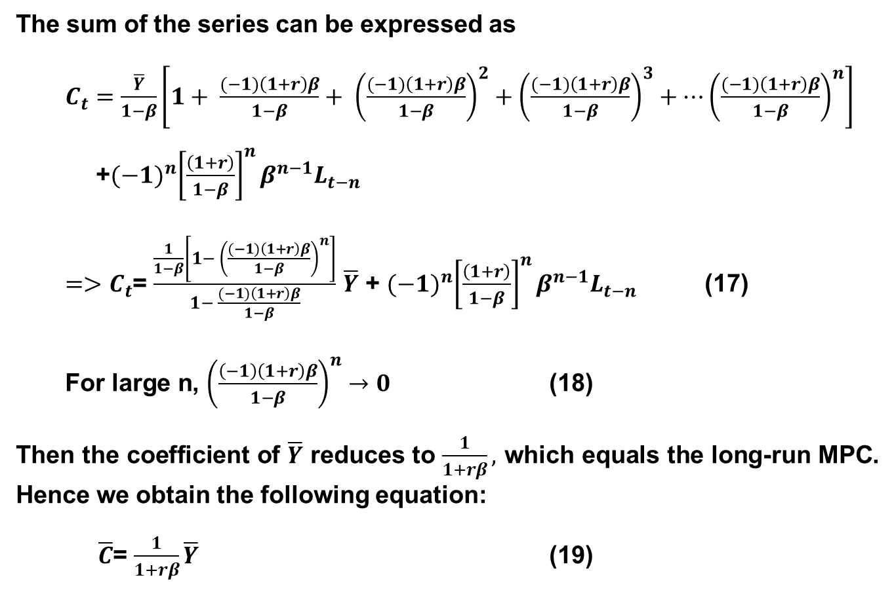
The sum of the series can be expressed as
$C_{t}=\frac{\overline{Y}}{1−β}\left[1+ \frac{(−1)\left(1+r\right)β}{1−β}+ {\left(\frac{(−1)\left(1+r\right)β}{1−β}\right)}^{2}+{\left(\frac{(−1)\left(1+r\right)β}{1−β}\right)}^{3}+…{\left(\frac{(−1)\left(1+r\right)β}{1−β}\right)}^{n}\right]$
+${(−1)}^{n}{\left[\frac{\left(1+r\right)}{1−β}\right]}^{n}β^{n−1}L_{t−n}$
${=>C}_{t}$= $\frac{\frac{1}{1−β}\left[1− {\left(\frac{(−1)\left(1+r\right)β}{1−β}\right)}^{n}\right]}{1− \frac{(−1)\left(1+r\right)β}{1−β}}$ $\overline{Y}$ + ${(−1)}^{n}{\left[\frac{\left(1+r\right)}{1−β}\right]}^{n}β^{n−1}L_{t−n}$ (17)
For large n, ${\left(\frac{\left(−1\right)\left(1+r\right)β}{1−β}\right)}^{n}→0$ (18)
Then the coefficient of $\overline{Y}$ reduces to $\frac{1}{1+rβ},$ which equals the long-run MPC. Hence we obtain the following equation:
$\overline{C}$= $\frac{1}{1+rβ}\overline{Y}$ (19)

Slide 13
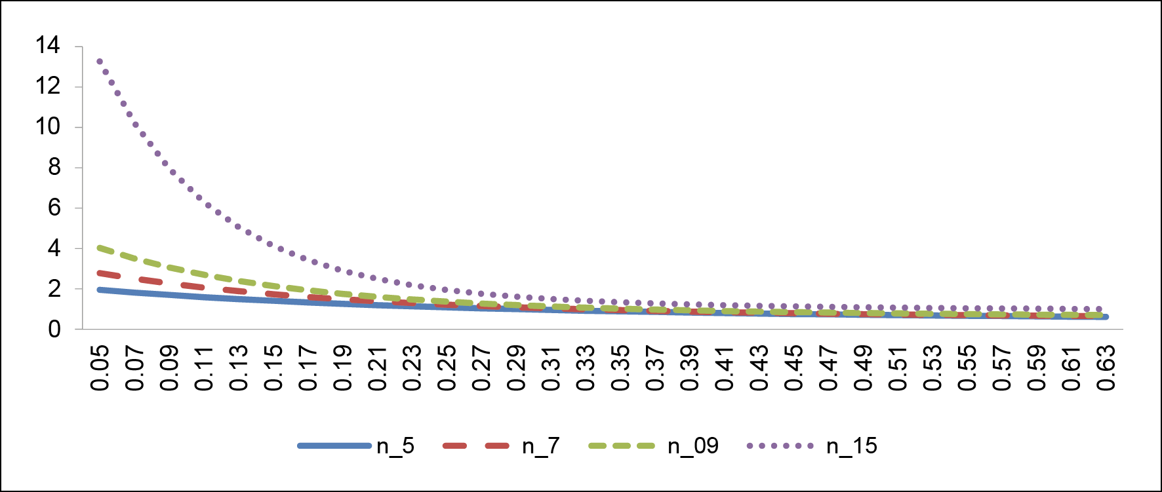
Borrowing Ratio for Varying n (a = 7%, β = 0.45)

Slide 14
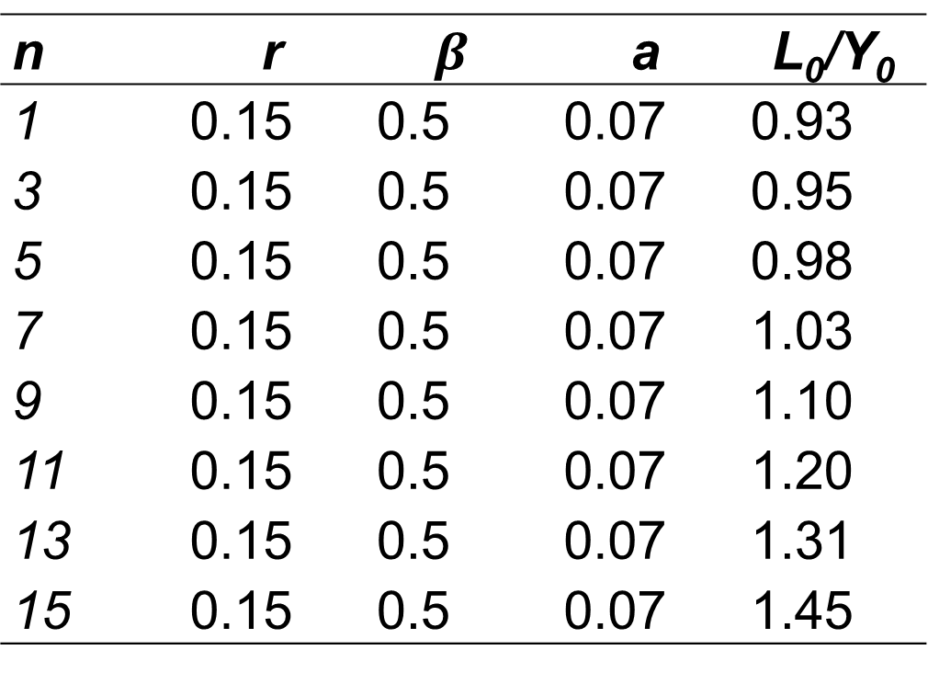
Estimated Borrowing Ratio for Varying n
n | r | $$β$$ | a | L₀/Y₀
1 | 0.15 | 0.5 | 0.07 | 0.93
3 | 0.15 | 0.5 | 0.07 | 0.95
5 | 0.15 | 0.5 | 0.07 | 0.98
7 | 0.15 | 0.5 | 0.07 | 1.03
9 | 0.15 | 0.5 | 0.07 | 1.10
11 | 0.15 | 0.5 | 0.07 | 1.20
13 | 0.15 | 0.5 | 0.07 | 1.31
15 | 0.15 | 0.5 | 0.07 | 1.45

Slide 15
Thank you for your attention

