Slide 1
Singapore Economic Review Conference
August, 2022,
The way to induce private financing into Green Investments and Green Bond
YOSHINO Naoyuki
Professor Emeritus, Keio University, Japan
Director, Financial Research Center,
Financial Services Agency (FSA), Government of Japan
yoshino@econ.keio.ac.jp

Slide 2
Outline
1, Green Projects and the way to increase the rate of return
2, Community based Crowd Funding
3, ESG Investment and Optimal Portfolio
4, Green bond
5, GHG Tax
6, Green Central Bank
7, SMEs’ efforts to reduce GHG emission

Slide 3
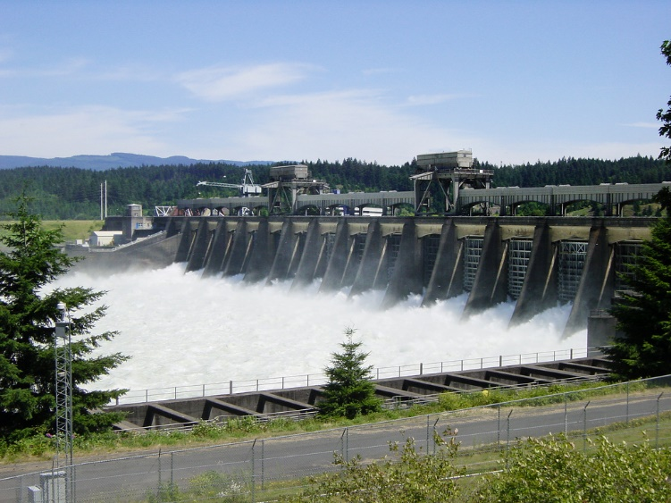
Green energy projects are categorized into two groups based on scale:
A) large projects: Hydro-power
B) Community type green energy projects (Hometown Crowd Funds)
Large projects can be financed by i) insurance and pension funds, that have long-term Financing.
long-term Projects (10-20 years),
Bank loans (1-5 years).
Hydropower plant

Slide 4
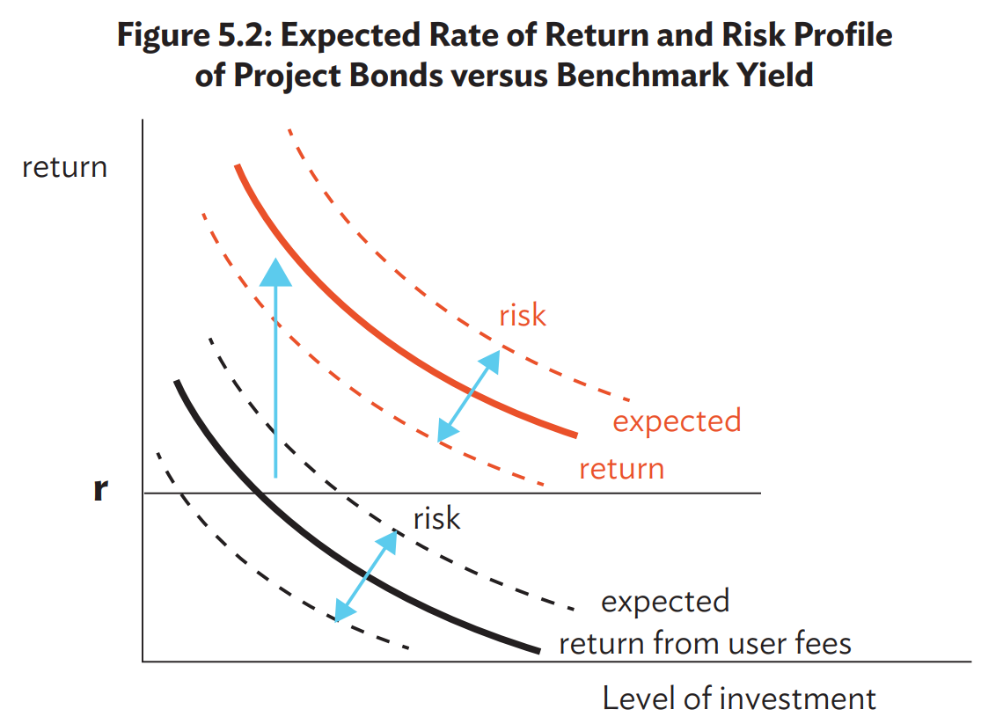
Source: Yoshino, Lakhia and Yap (2021) ADB Book Chapter

Slide 5
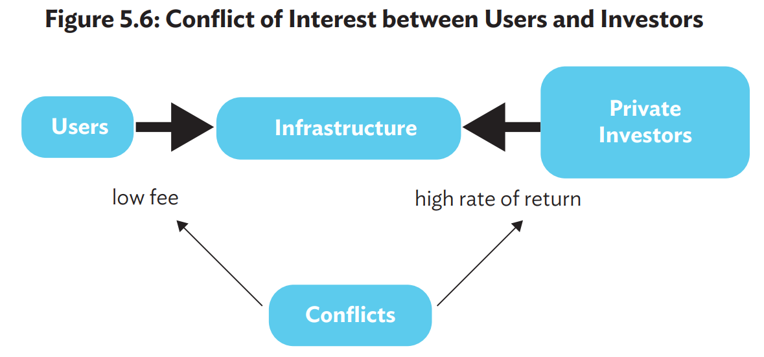
Yoshino, N., S. Lakhia, and J. T. Yap. (2021). “Financing Sustainable Infrastructure Investment in ASEAN+3”. in Guinigundo, D., Kawai, M., Park, C. Y., Rajan, R. S. Redefining Strategic Routes to Financial Resilience in ASEAN+3. Manila, Philippines, ADB.

Slide 6

Injection of Increased tax revenues from the spillover effect into energy projects in order to increase the rate of return for private investors
Spill over effects of electricity supply
Non-affected region
Business development
Private investment
Employment
Electricity Supply
Spillover Effect
Non-affected region
Spillover Effect and increase of sales & property tax revenue
Source: Yoshino and Taghizadeh-Hesary (2017)

Slide 7
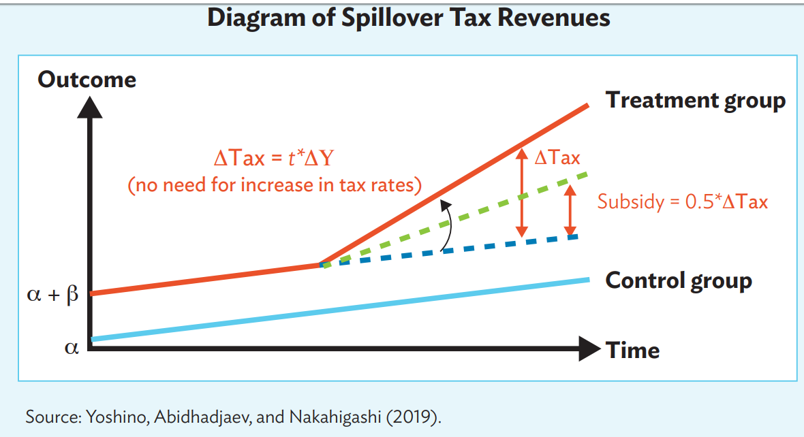

Slide 8
Possible Solutions
by use of community funds
For Risky businesses
Hometown Investment Trust Funds
-----------------------------------
A Stable Way to Supply Risk Capital
Yoshino, Naoyuki; Kaji Sahoko (Eds.), 2013,

Slide 9
Financing Scheme for Renewable Energy Projects Using HITs and Carbon Tax
Injection of
Spillover Tax revenues
HIT = Hometown Investment Trust Fund.
Source: Authors.

Slide 10
Current ESG investment: distort asset allocation
1, Traditional asset allocation :
two parameter approach
(i) Rate of return (R), (ii) Risks (σ²)
2, ESG component is added for the asset allocation
(iii) ESG multi-factor model
3, ESG criteria is different from one rating agency to another
4, Each Investor changes its’ asset allocation based on specific criteria of ESG given by rating agency

Slide 11
ESG score
Green score
U
f
B
$${ESG}_{B}$$
U
Return
A
$${ESG}_{A}$$
U
e
U
B
A
f
σ: Risk

Slide 12
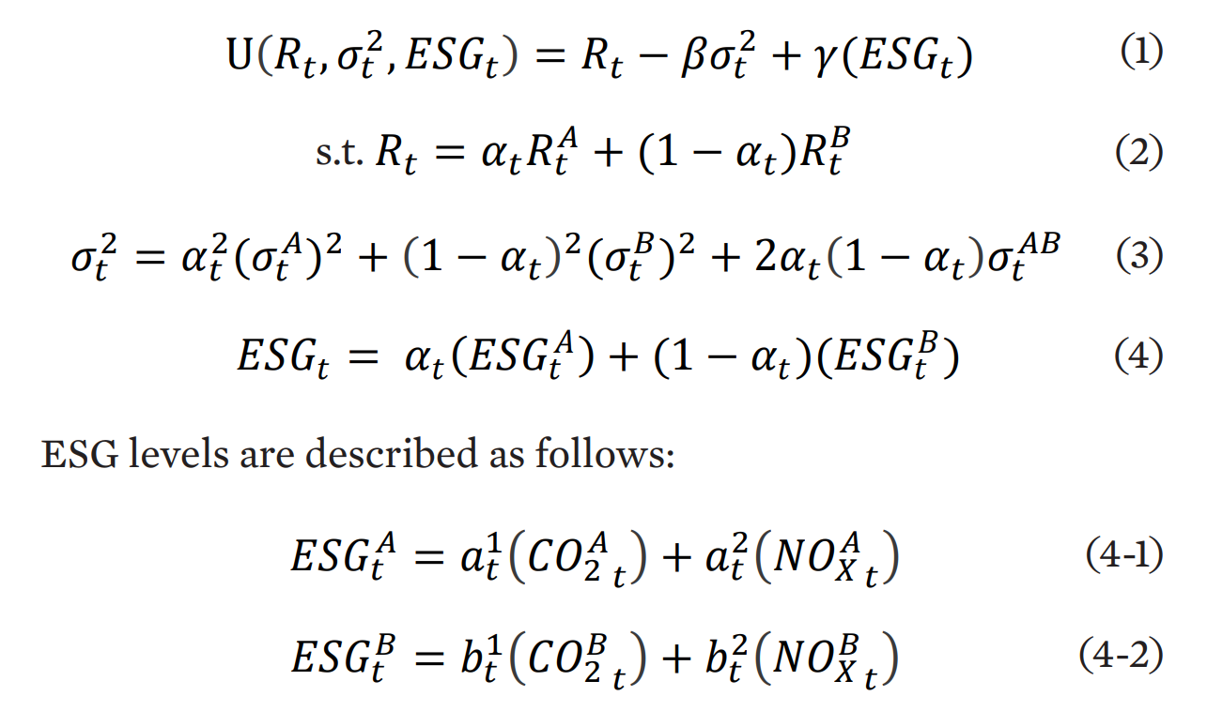
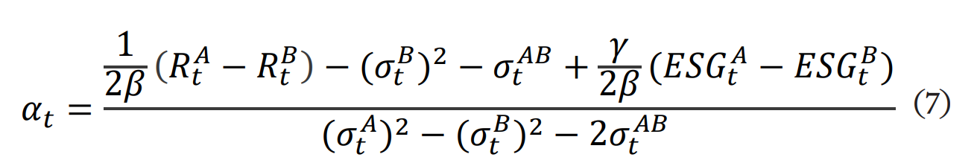
Portfolio Allocation including ESG scores
Optimal Portfolio Allocation taking into consideration of ESG scores

Slide 13
The evaluation methodologies and criteria for ESG scores vary from one evaluating organization to another. For example, (1) some agency uses its own criteria to evaluate a company's ESG efforts, (2) some agency assign a score based on the degree of disclosure, (3) some agency uses a score based on whether or not the company has an ESG policy, (4) some agency uses a score based on actual ESG activities such as carbon dioxide reduction by judging from performance, and so on (Table 1). It also raises issues whether ESG scores actually reflect ESG activities and outcomes by companies (Chatterji et al. 2009, Drempetic et al. 2019).

Slide 15
The allocation of assets between A and B changes which ESG rating agencies’ ESG score is used for the portfolio allocation.
The higher ESG score value is the higher α, and thus the higher the investment allocation. For example, since Sustainalytics is the highest ESG score for Company A, investors following this rating will have the highest allocation to Company A.
On the other hand, the Bloomberg score is lower for Company A than for Company B, resulting in a smaller investment allocation.
If we do not take into account the ESG score, the investment allocation to Company A is 0.57

Slide 16

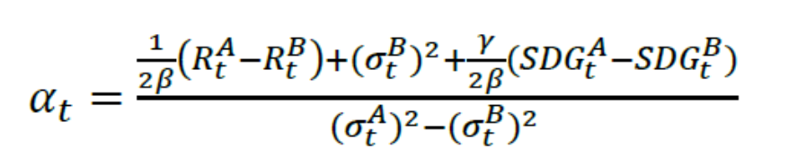




U=R-βσ^{２}+γ(ESG)
ESG Score
g
D
U
$${ESG}_{D}$$
f
B
SDG
ESG
Greenness
$${ESG}_{B}$$
U
C
R(Return)
$${ESG}_{C}$$
A
U
$${ESG}_{A}$$
e
U
f
g
B
A
σ(Risk)

Slide 17
Optimal portfolio allocation can be achieved by taxing waste products
1, By taxing wastes such as CO2, NOX, Plastics etc. by identical international tax rate, the investors can only look for “after tax rate of return” and “risks” as they were conventionally focused on.
2, Firm level - International taxation will lead to optimal asset allocation and achieve sustainable growth

Slide 18
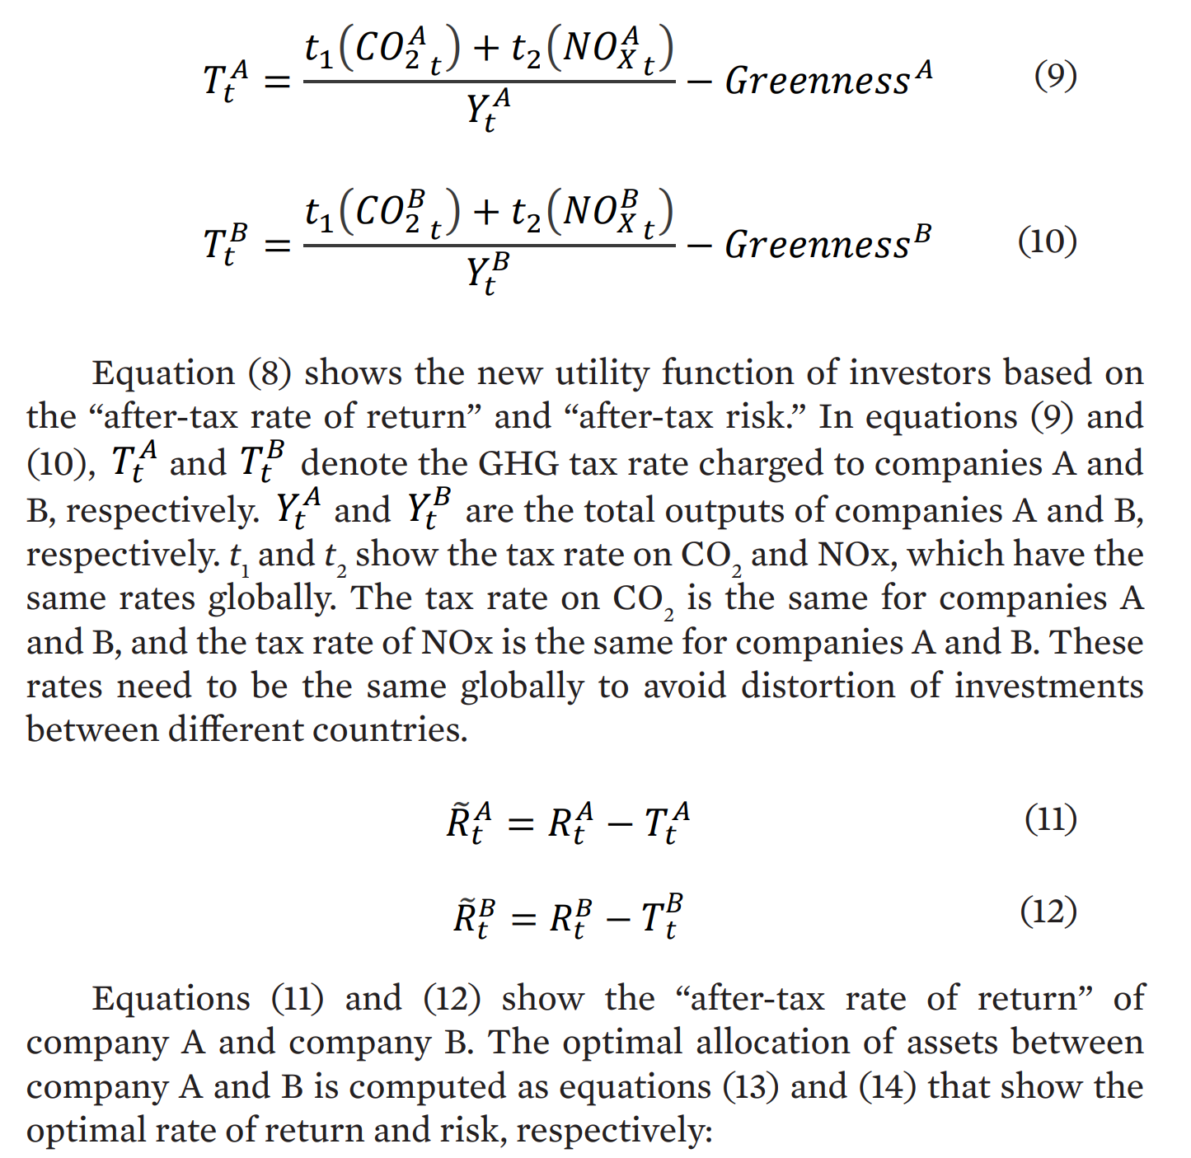
Greenness Adjusted
GHG Taxation

Slide 19
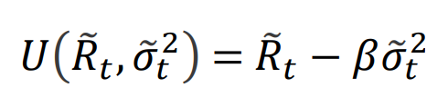
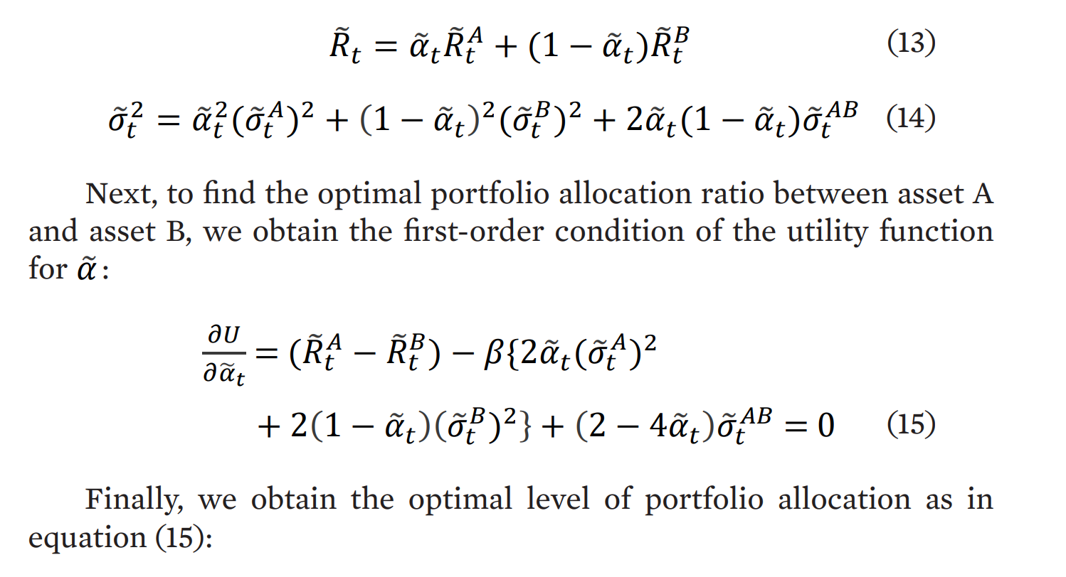
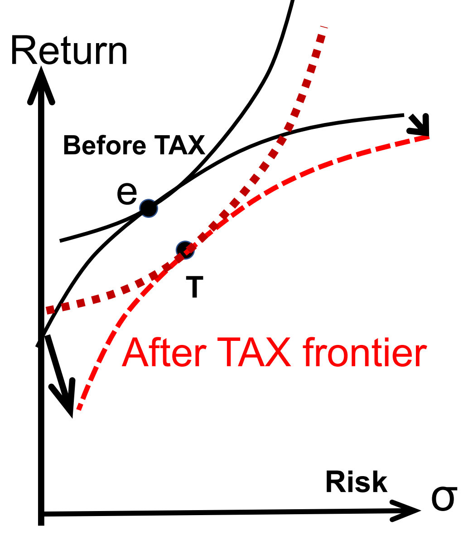
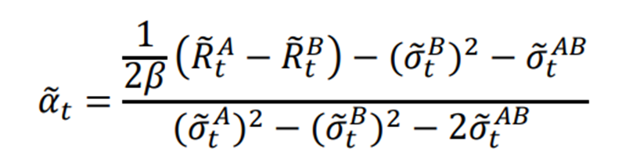
Portfolio
Optimization
taking into account of GHG Tax

Slide 20

Satellite photo can measure the amount of CO2 exposure

Slide 21
ESG Investment and Stock Price

Slide 22
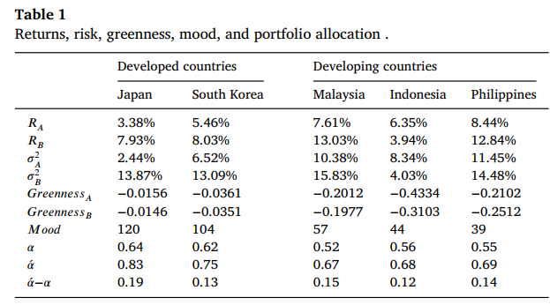
Greenness, mood, and portfolio allocation:
A cross-country analysisYOSHINO and Mumtaz(2021)
A R T I C L E I N F O |  | A B S T R A C T
Keywords: Utility function Greenness Investors’ sensitivity Portfolio allocation |  | This study estimates the utility function, including the rate of return, riskiness, greenness, and mood across selected countries. We incorporate mood as investors’ sensitivity or momentum towards environmental issues. This study assumes that higher sensitivity of environmental issues compels the firms to follow green measures. We report that the proportion of investment is higher if the firms account for greenness measures. This study compares the results of five Asian economies and reports that Japanese and South Korean firms are following the greenness measures. However, the firms locating in developing countries are far behind in implementing greenness measures. Our regression results also suggest that greenness and mood x greenness positively influence stock returns.

Slide 23
International Capital Market Association

Slide 25
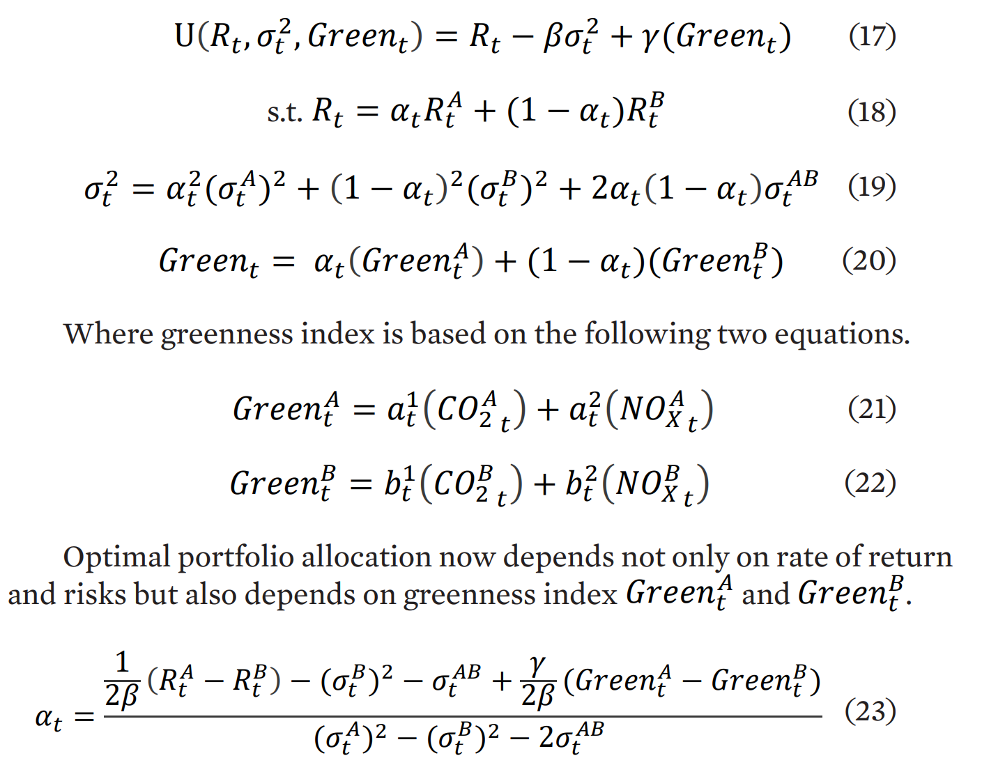
Green Bond
and
Optimal
Portfolio
Allocation

Slide 26
Green Central Banking
①Central Bank
②Central Bank
Gold | Monetary Base
Ordinary Government Bond
Green Bond
Gold | Monetary Base
Ordinary Government Bond
Fiscal Policy
Education
Tax Revenues
G
Infrastructure
Government Bond
Green Sector

Slide 27
<Green Bond purchaser by the Central Bank>
Ordinary Government Bond
Money Supply
Central Bank
Green Bond
Government Bond
Green Sector
Fiscal Policy
Central Bank
Money Supply

Slide 28

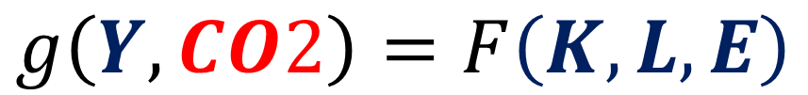

Joint Production Function
$$g\left(Y,CO2\right)=F\left(K,L, E\right)$$
Output
Capital, Labor, Energy
Profits$=P×Y$ーτ $×$CO2
Costs$=r×K+w×L+PE×$E $×$(1+τ ）
No explicit costs for CO2.

Slide 29
Stock owners
Large Business
Corporate bond holders
Pressure from the market
Banks
Banks
MSMEs
Informal market
No market pressure

Slide 30
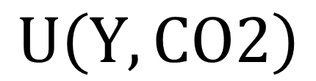
$$U\left(Y,CO2\right)$$
Y
e
e
ｆ
K
CO2
K

Slide 31
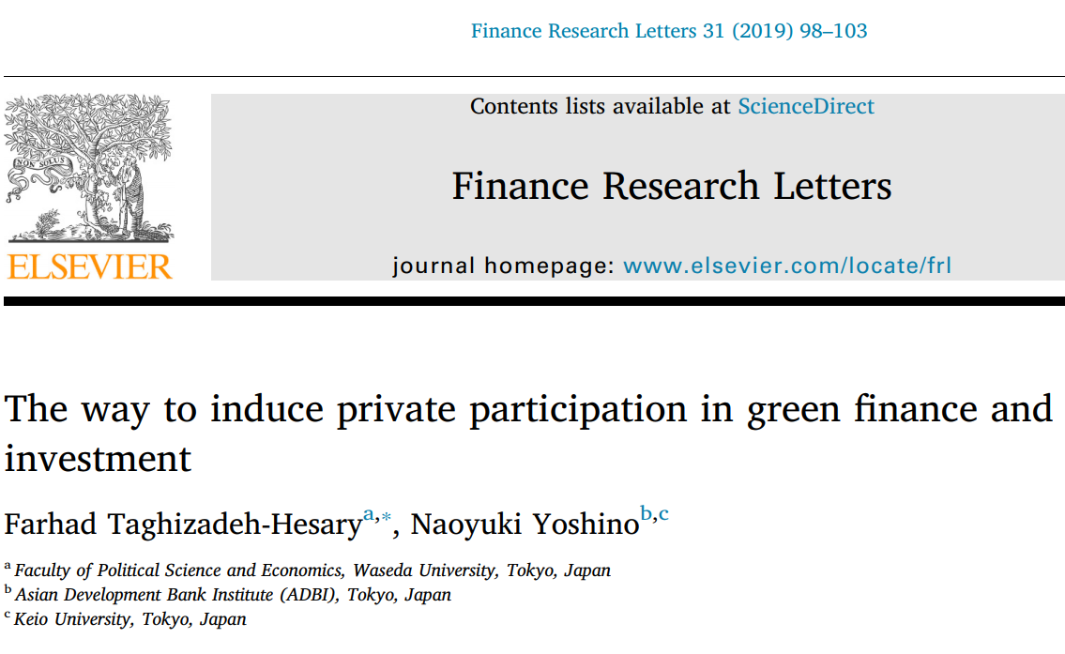

Slide 32
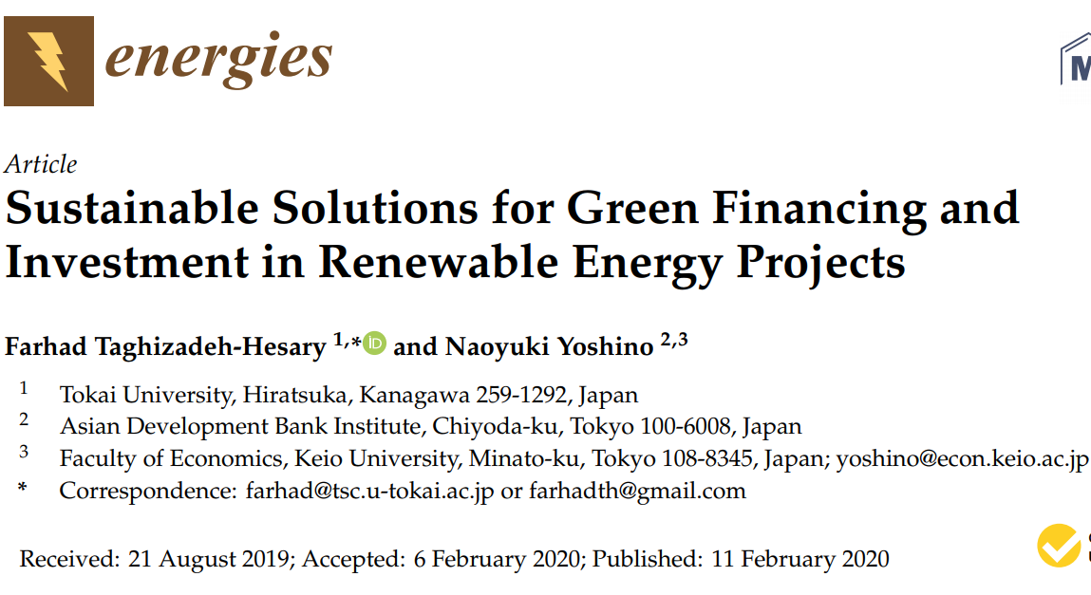

Slide 33


Slide 34
