Slide 1
Spillover Effects of Infrastructure Investment
Naoyuki YOSHINO
Adjunct Professor at GRIPS j
Professor Emeritus (Economics) Keio University
Adjunct Professor at GRIPS
Former Dean/CEO Asian Development Bank Institute
yoshino@econ.keio.ac.jp

Slide 2
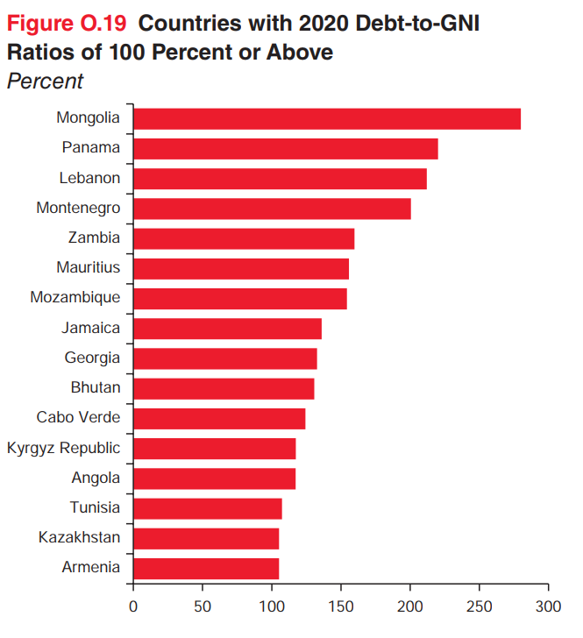
Source: World Bank

Slide 3
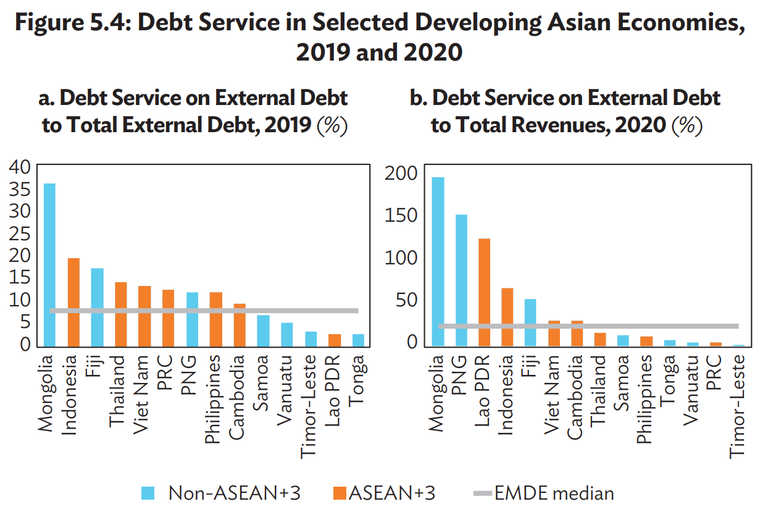

Slide 4

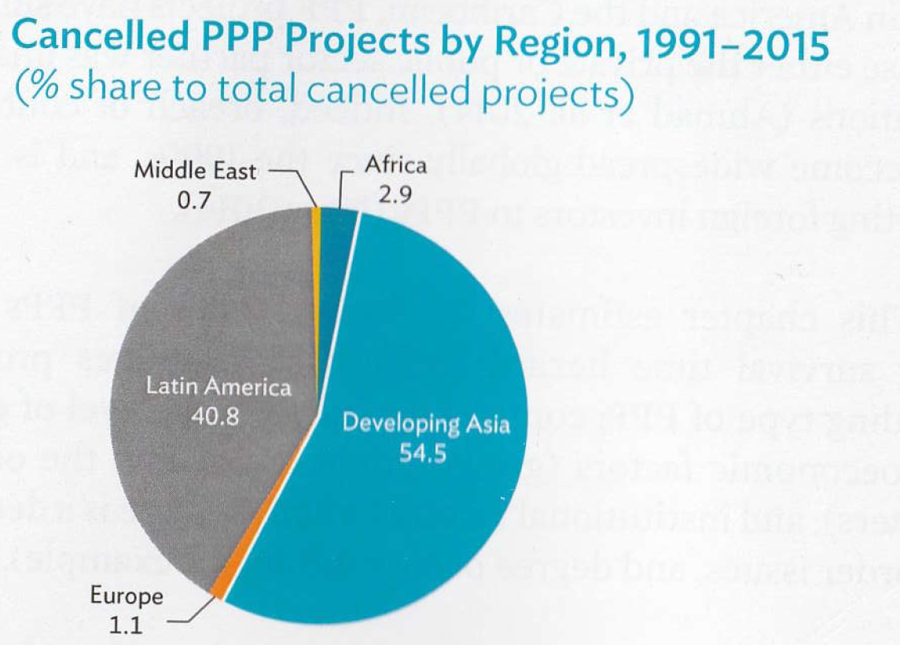
Realizing The Potential of Public Private Partnerships to Advance Asia’s Infrastructure Development
Akash Deep
Jungwook Kim
Minsoo Lee
ADB (2019)

Slide 5
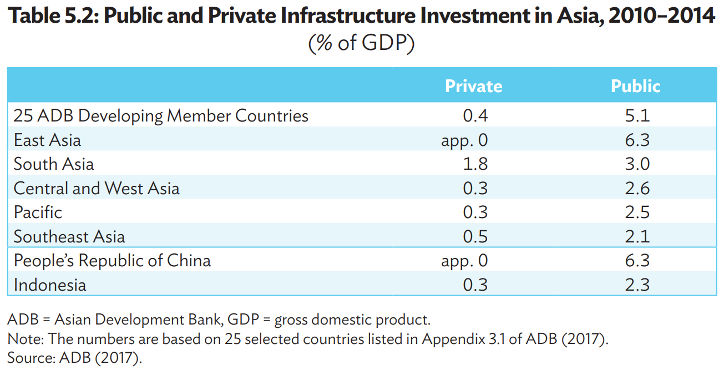

Slide 6
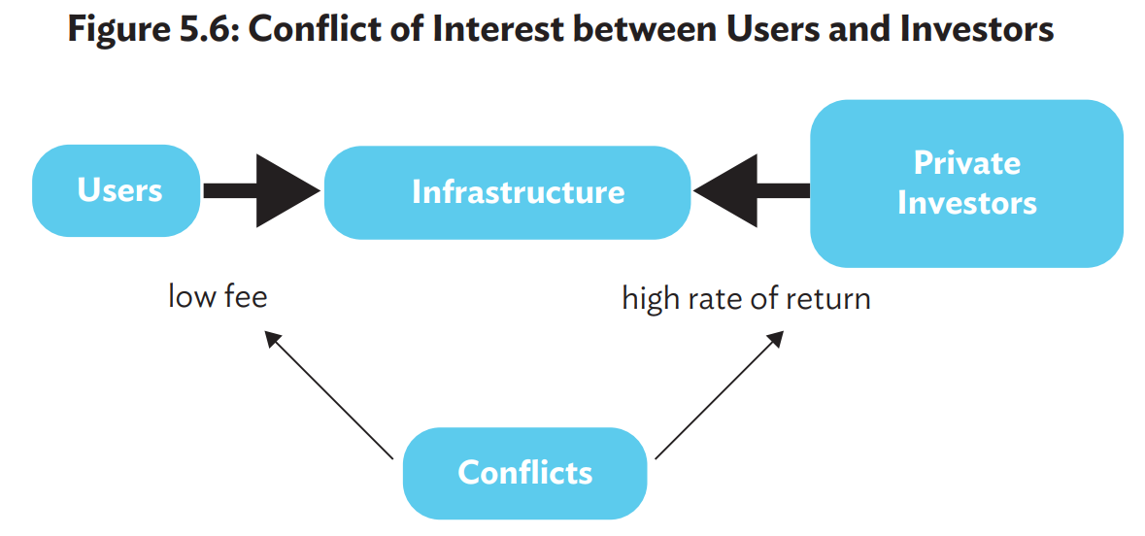
Yoshino, N., S. Lakhia, and J. T. Yap. (2021). “Financing Sustainable Infrastructure Investment in ASEAN+3”. in Guinigundo, D., Kawai, M., Park, C. Y., Rajan, R. S. Redefining Strategic Routes to Financial Resilience in ASEAN+3. Manila, Philippines, ADB.

Slide 7
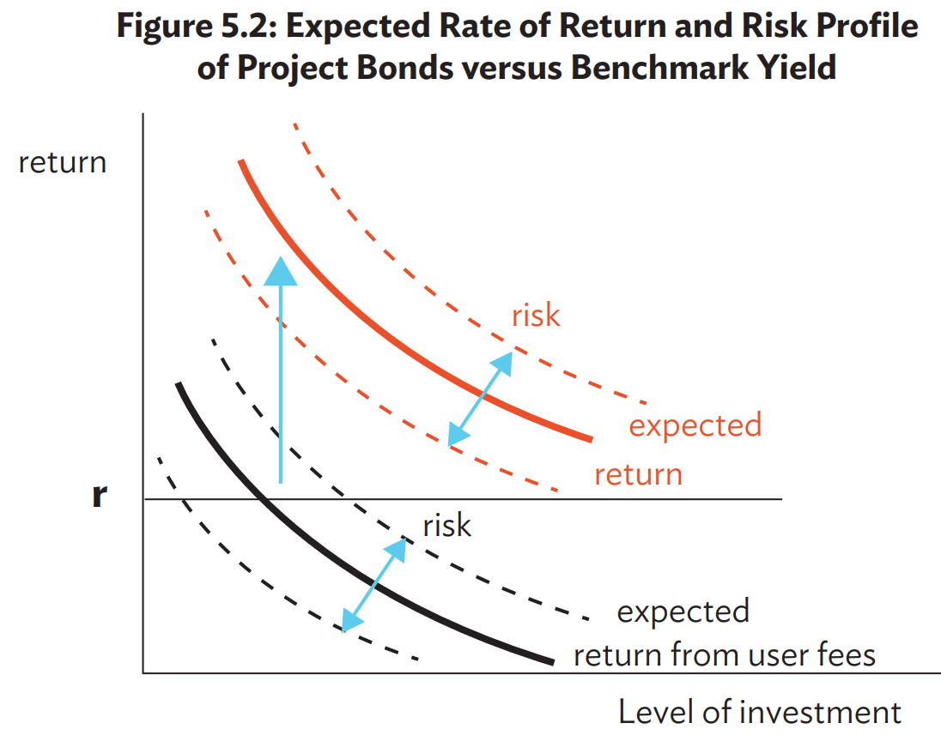

Slide 8
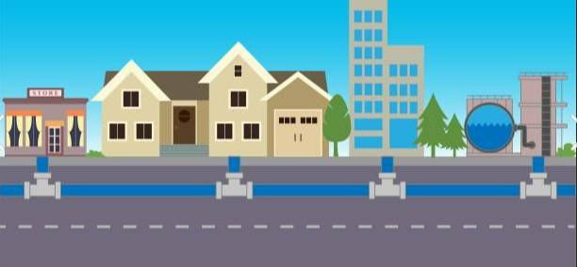





Spillover Effects of Water Supply
Increase of Spillover Tax Ｒｅｖｅｎｕｅｓ
New Housing & Offices
School
Water Supply
Manufacturing

Slide 9


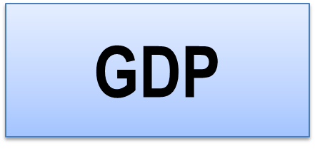
Economic Effects of infrastructure
Effects on total GDP
L= Labor Agricultural sector
Kp = Private Capital Manufacturing sector
Kg = Infrastructure Services’ sector
(GDP) Y = F (Kp, L, Kg, )

Slide 10
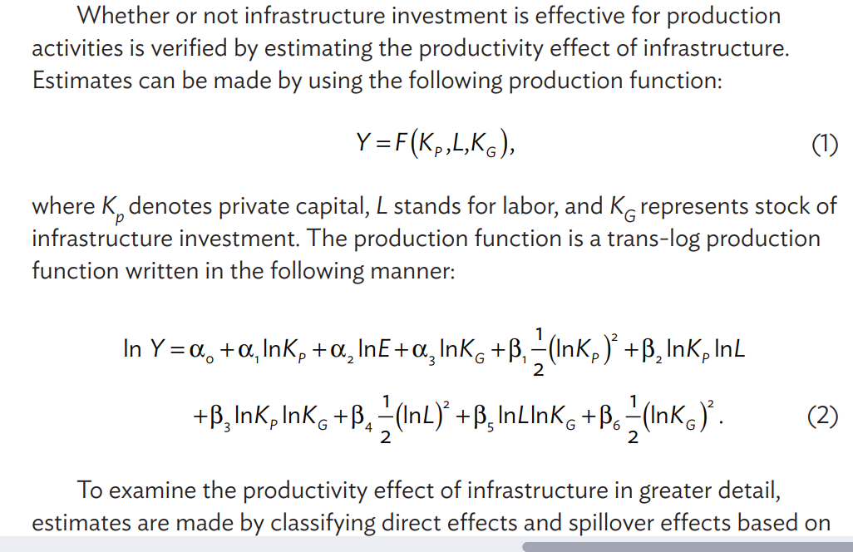
Trans-log Production Function

Slide 11

Research Question
How does Infrastructure development affect tax revenues?
Spillover Effects of digital infrastructure
e-business
e-commerce
remote education
Employment
New Residents
New Businesses
Spillover effect
→ Increase in Tax revenues

Slide 12
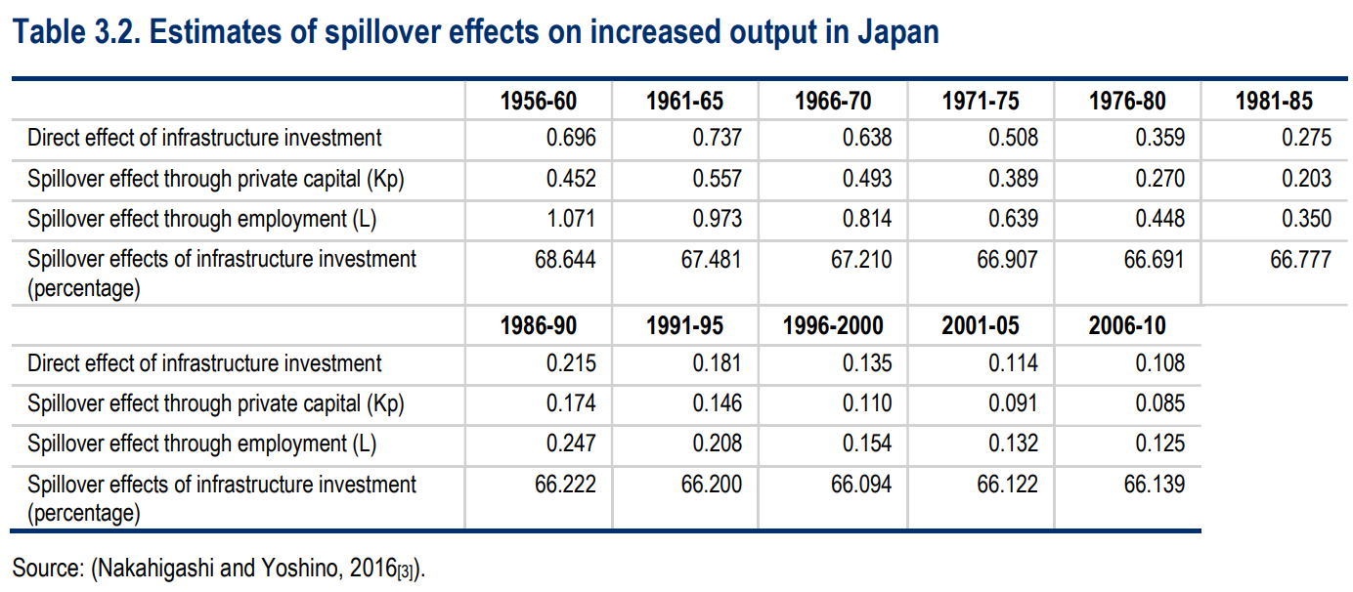

Slide 13
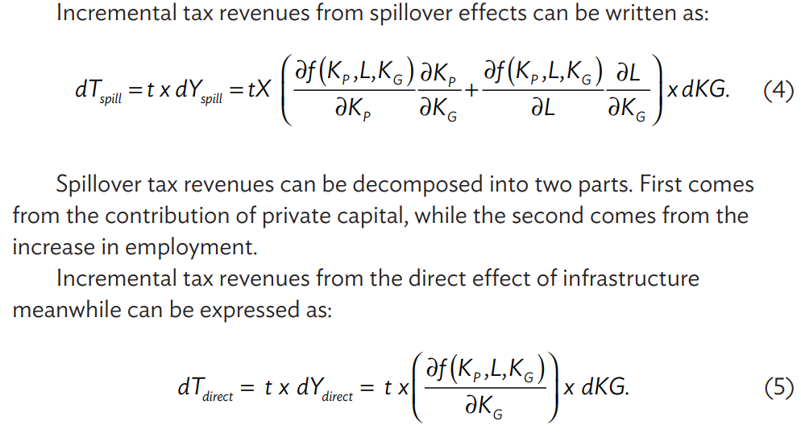
Spillover Tax Revenues

Slide 14
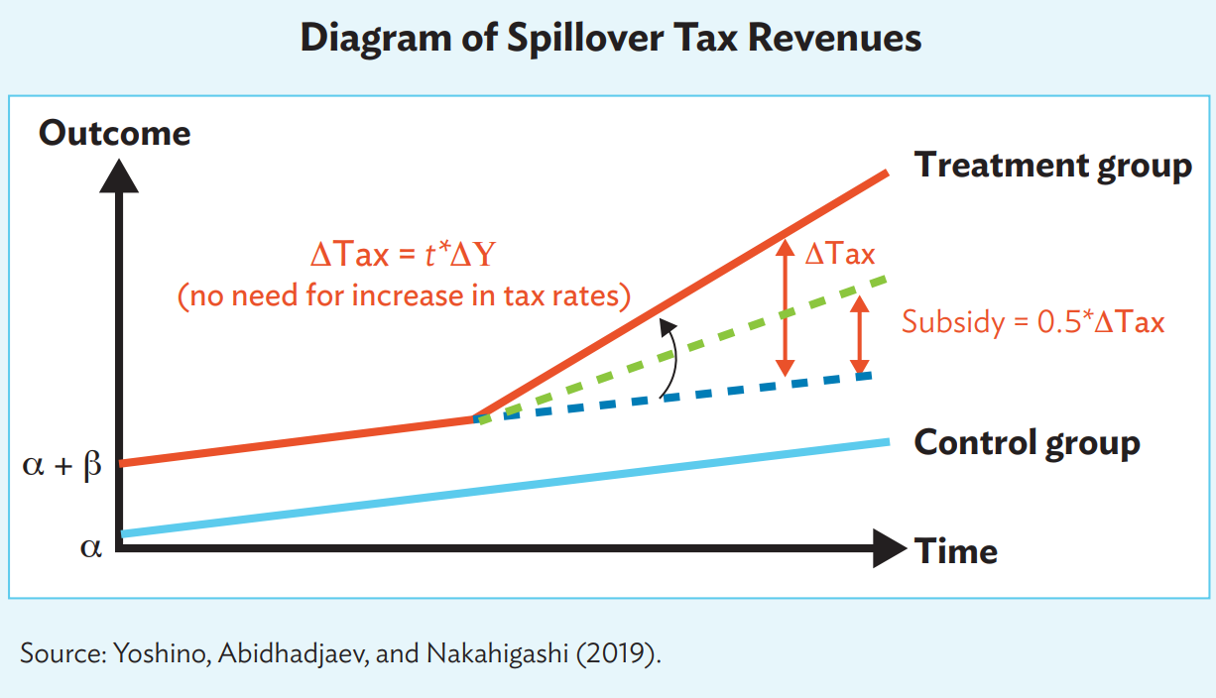

Slide 15
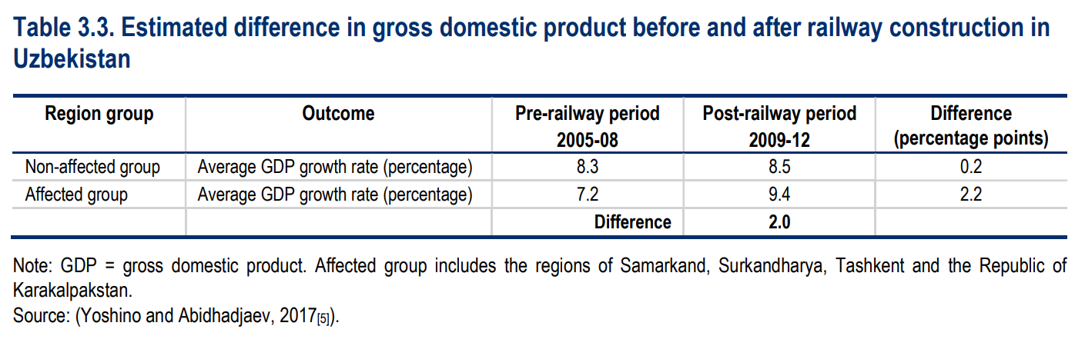
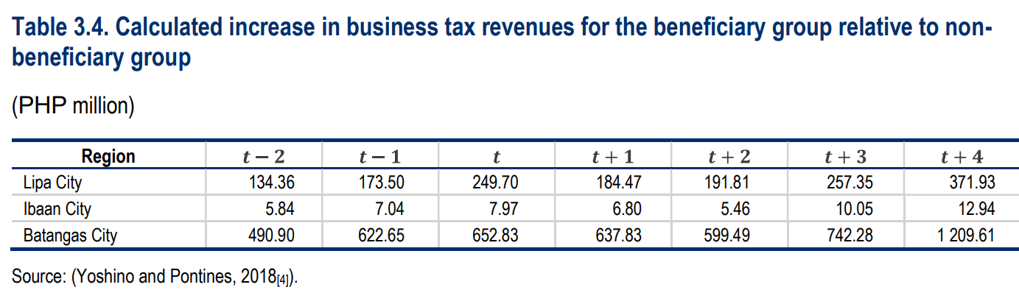

Slide 16
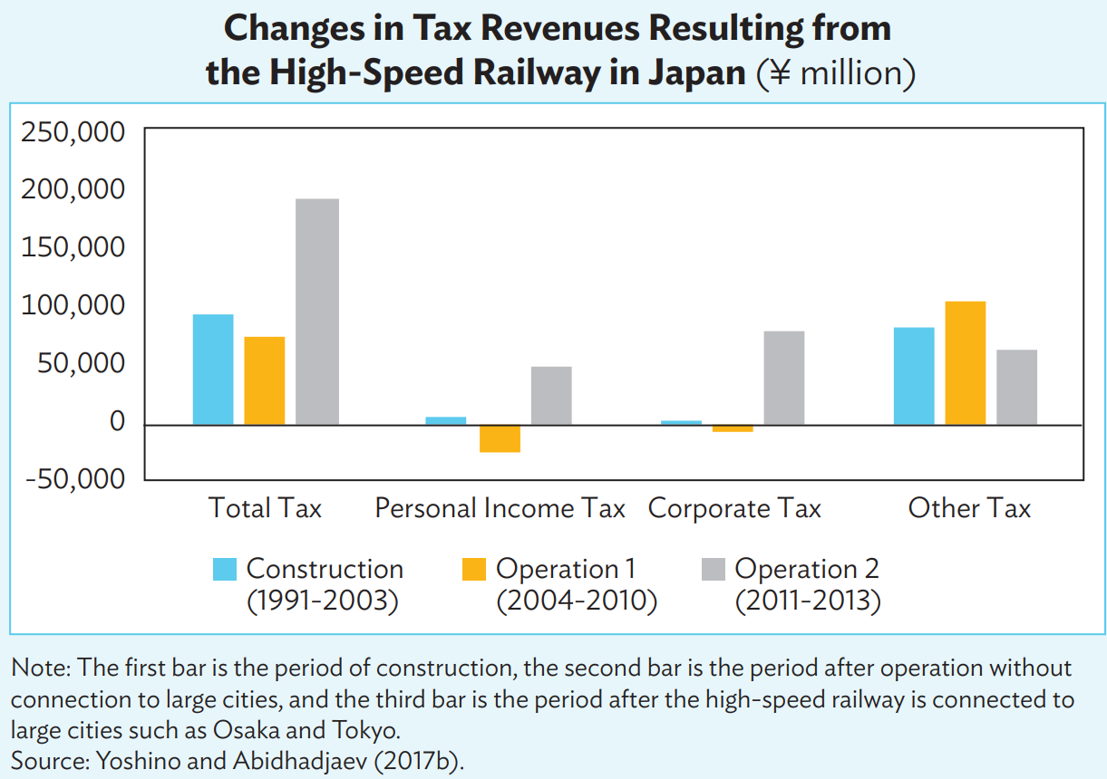
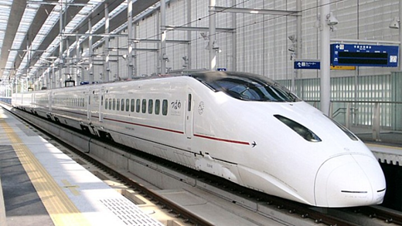

Slide 17
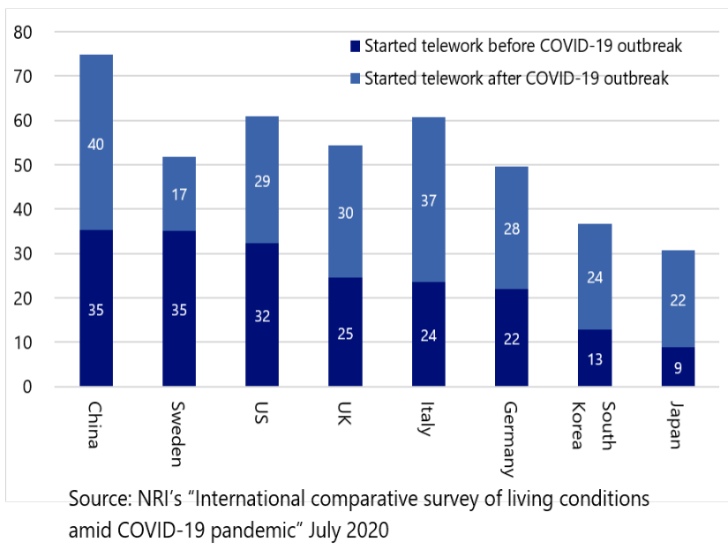
Important Role of ICT (Information and Communication Technology) during the Pandemic
Telework
During the pandemic, ICT is becoming more important → increase in the share of workers teleworking.
Digital inequality poses challenges for some workers to telework. Eg: in the survey by NRI, the results for China and South Korea are only representative for urban population due to poor connectivity in rural areas.
In Ono, H. and Mori, T., (2021)

Slide 18
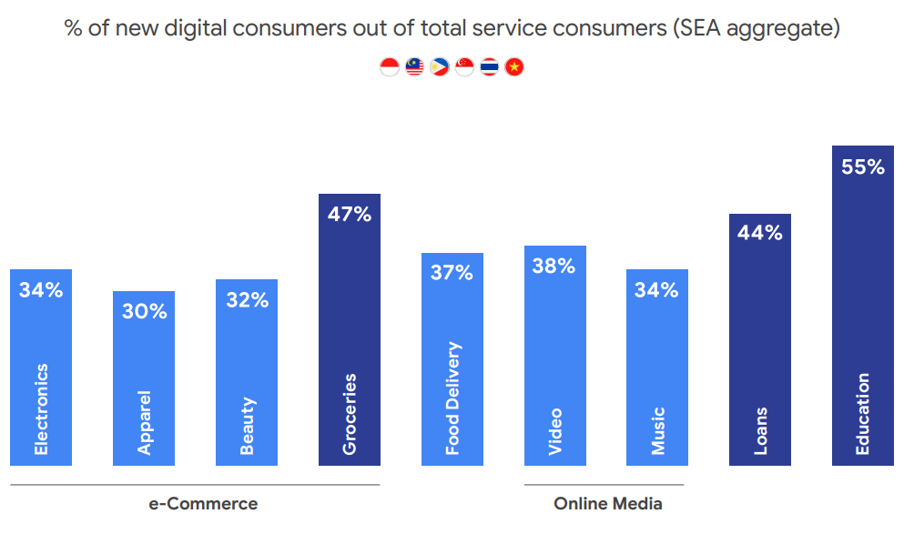
Important Role of E-Commerce
during the Pandemic
Share of e-commerce in global retail trade went up from 14% in 2019 to 17% in 2020 (UNCTAD 2021).
Source: Google, Temasek, and Bain&Co (2021)

Slide 19
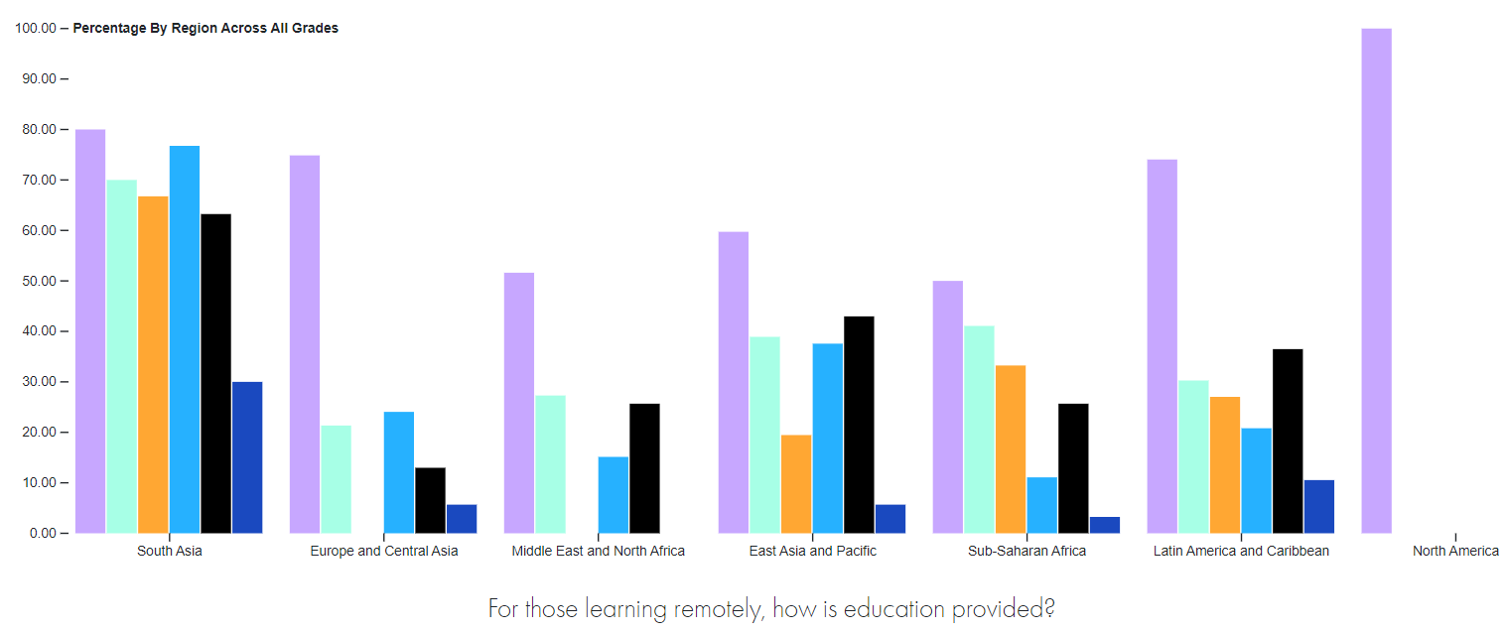
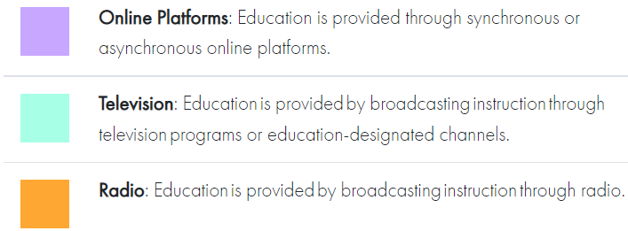
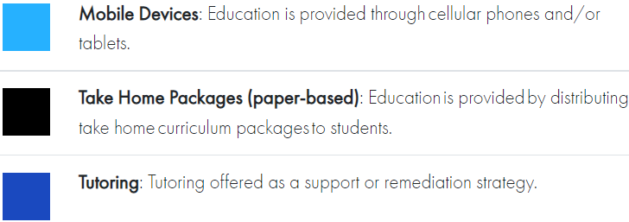
Online Education during the Pandemic
Many countries rely on multiple modes of remote learning. Many relied on the internet and mobile phones.
North America
South Asia
East Asia and Pacific
Online Platforms
Source: John Hopkins University, World Bank, and Unicef (2021)

Slide 20
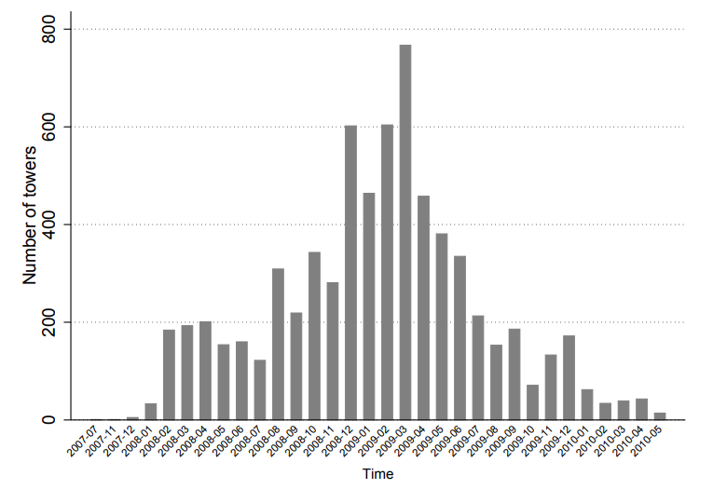
Shared Mobile Infrastructure Scheme (SMIS) by Use of Indian Government Budget
In 2007, the Indian gov’t launched the SMIS program which provided subsidies to telecom operators for the construction and maintenance of mobile towers in identified rural areas without existing mobile coverage.In 2007-2013, 7,353 towers were constructed.
Construction of Mobile Towers （2007-2010)
Source: Gupta et. al. 2021

Slide 21
GSM (Global System for Mobile Communications) subscribers
Number of GSM subscribers by year (average of all states)
GSM subscribers per capita by state
(average 2005-2016)
Delhi
State No.
Note: 1: Andhra Pradesh and Telangana; 2: Assam; 3: Bihar and Jharkhand; 4: National Capital Territory of Delhi; 5: Gujarat; 6: Haryana; 7: Himachal Pradesh; 8: Northern India; 9: Karnataka; 10: Kerala; 11: Madhya Pradesh and Chatishgarh; 12: Maharasthra, Goa, Dadra & Nagar Haveli, and Daman & Diu; 13: Odisha ;ª 14: Punjab; 15: Rajasthan; 16: Tamil Nadu and Puducherry; 17: Uttar Pradesh and Uttaranchal; 18: West Bengal and Sikkim; 19: North East. Note that the capital territory of Delhi has no central tax revenue.
Source: Authors’ calculations using data from COAI.

Slide 22
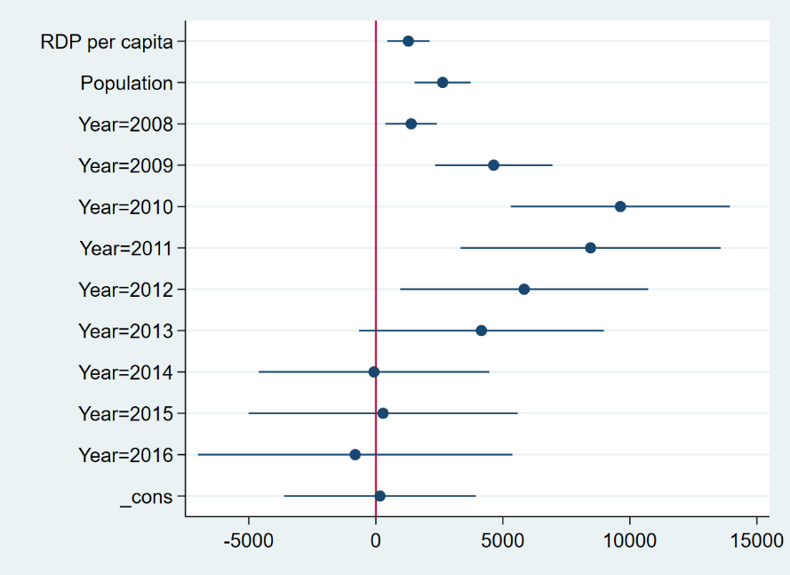
Did SMIS (Shared Mobile Infrastructure Scheme) program increase the number of mobile subscribers?
${ΔSubscribers}_{it}=β_{0}+β_{1}Δ{GDPcap}_{it}+ β_{2}Δ{Population}_{it}+v_{i}+δ_{t}+u$_{i t}
Number of GSM subscribers increased significantly during 2009-2011, when the mobile towers were mostly built by the government.
Need Private money to increase mobile towers.
Coefficient plot
The lines represent a 90% confidence interval

Slide 23
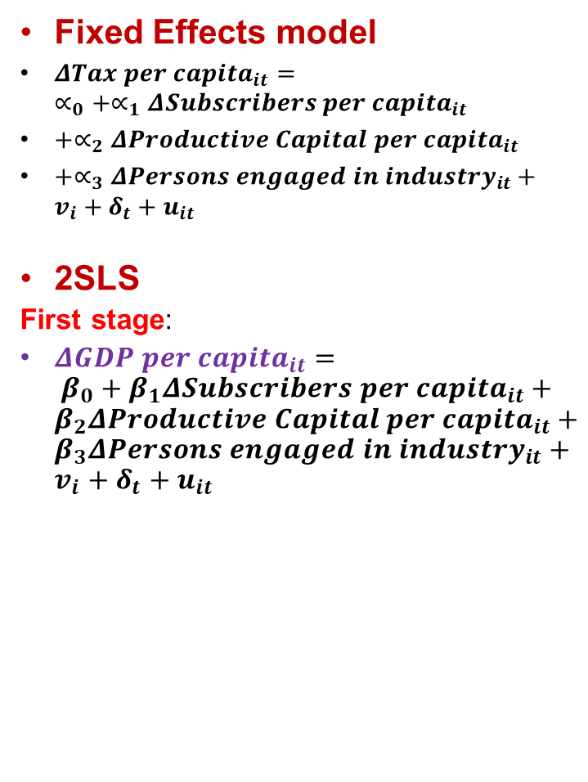
Estimation Strategy
Fixed Effects model
${ΔTax per capita}_{it}=∝_{0}+∝_{1}Δ{Subscribers per capita}_{it}$
$+∝_{2}Δ{Productive Capital per capita}_{it}$
$+∝_{3}Δ{Persons engaged in industry}_{it}+v_{i}+δ_{t}+u_{it}$
2SLS
First stage:
${ΔGDP per capita}_{it}= {β_{0}+β}_{1}Δ{Subscribers per capita}_{it}+β_{2}Δ{Productive Capital per capita}_{it}+β_{3}Δ{Persons engaged in industry}_{it}+v_{i}+δ_{t}+u_{it}$
Actual and Predicted Values of GSM Subscribers and Total State Tax Revenue
Δ GSM
Δ Tax
Second stage:
$${ΔTax per capita}_{it}=∝_{0}+∝_{1}\hat{Δ{GDP per capita}_{it}}+v_{i}+δ_{t}+u_{it}$$

Slide 24
Discussion of the Results
Average total revenue obtained from subscriber fees of mobile operators in 2016 = 1,221,318 mio (Telecom Regulatory Authority of India).
Average total state tax increase (
= 134 * 1,291 mio (population in 2016) = 172,994
→ Tax increment = 172.994/1221.318=0.142 or 14.2% compared to total revenue from fees

Slide 25
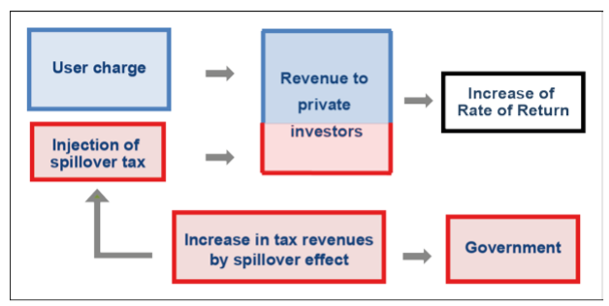
Policy Implications
One way to ensure that private sector remains attracted to infrastructure development is to provide a steady stream of income for them. We argue that that could be achieved by sharing the spillover effects of ICT infrastructure on taxes obtained by the government with the investors/operators of the infrastructure
The amount of tax revenues to be shared by the gov’t with the investors can be calculated using trans log production function (Yoshino et. al. 2019)
Based on our estimation, if 50 % of increased tax revenues were returned to mobile operators, the rate of return will rise about 14.2%
Increased by 14.2%
Source: Yoshino et. al. (2019)

Slide 26
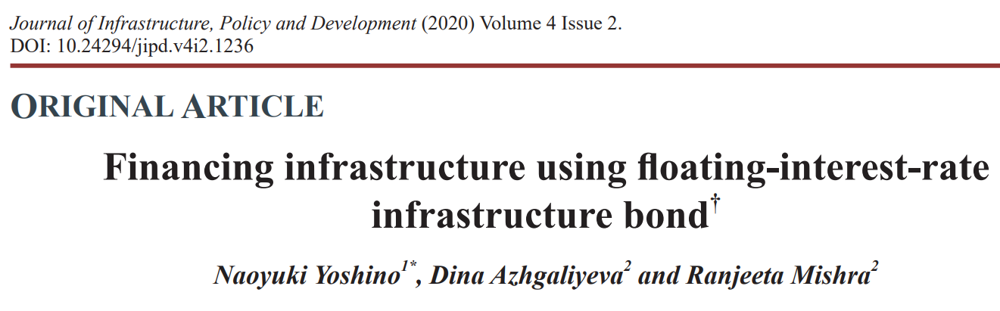

Slide 27
References
Yoshino, N., K. E. Seetharam, S. Miyazawa, and K. Xu. 2019. “Innovative Measures of Infrastructure Investments: Illustrating Land Trust Scheme and Spillover Effect”. ADBI Working Paper Series, No. 1053. December
Yoshino, N., D. Azhgaliyeva., and R. Mishra. 2020. “Financing infrastructure using floating-interest-rate infrastructure bond”. Journal of Infrastructure, Policy and Development. Vol. 4(2)
Yoshino, N., K. Xu., and K. E. Seetharam. 2020. “Land Trust Scheme and the Spillover Effects of Infrastructure Investment” in Hayashi, Y., K. E. Seetharam, S. Bharule. Handbook on High-Speed Rail and Quality of Life. Manila, Philippines, ADB.
Yoshino, N., S. Lakhia, and J. T. Yap. 2021. “Financing Sustainable Infrastructure Investment in ASEAN+3”. in Guinigundo, D., Kawai, M., Park, C. Y., Rajan, R. S. Redefining Strategic Routes to Financial Resilience in ASEAN+3. Manila, Philippines, ADB.

Slide 28
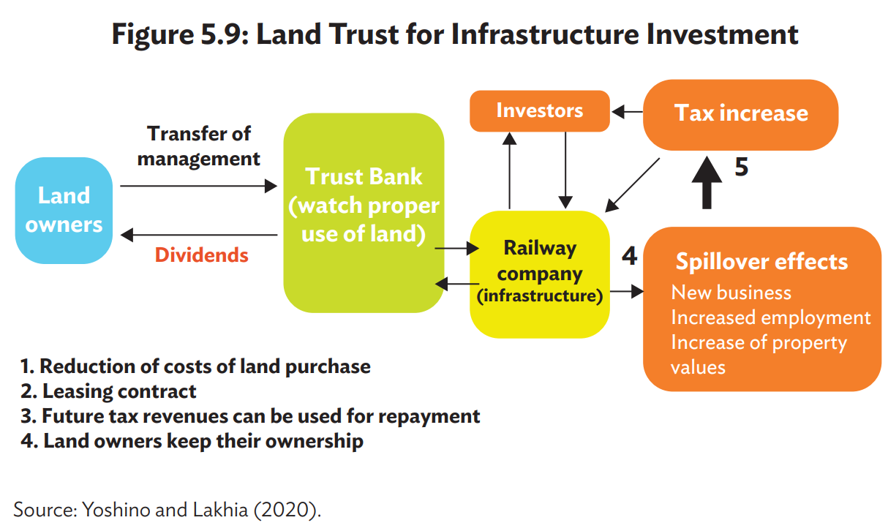

Slide 29
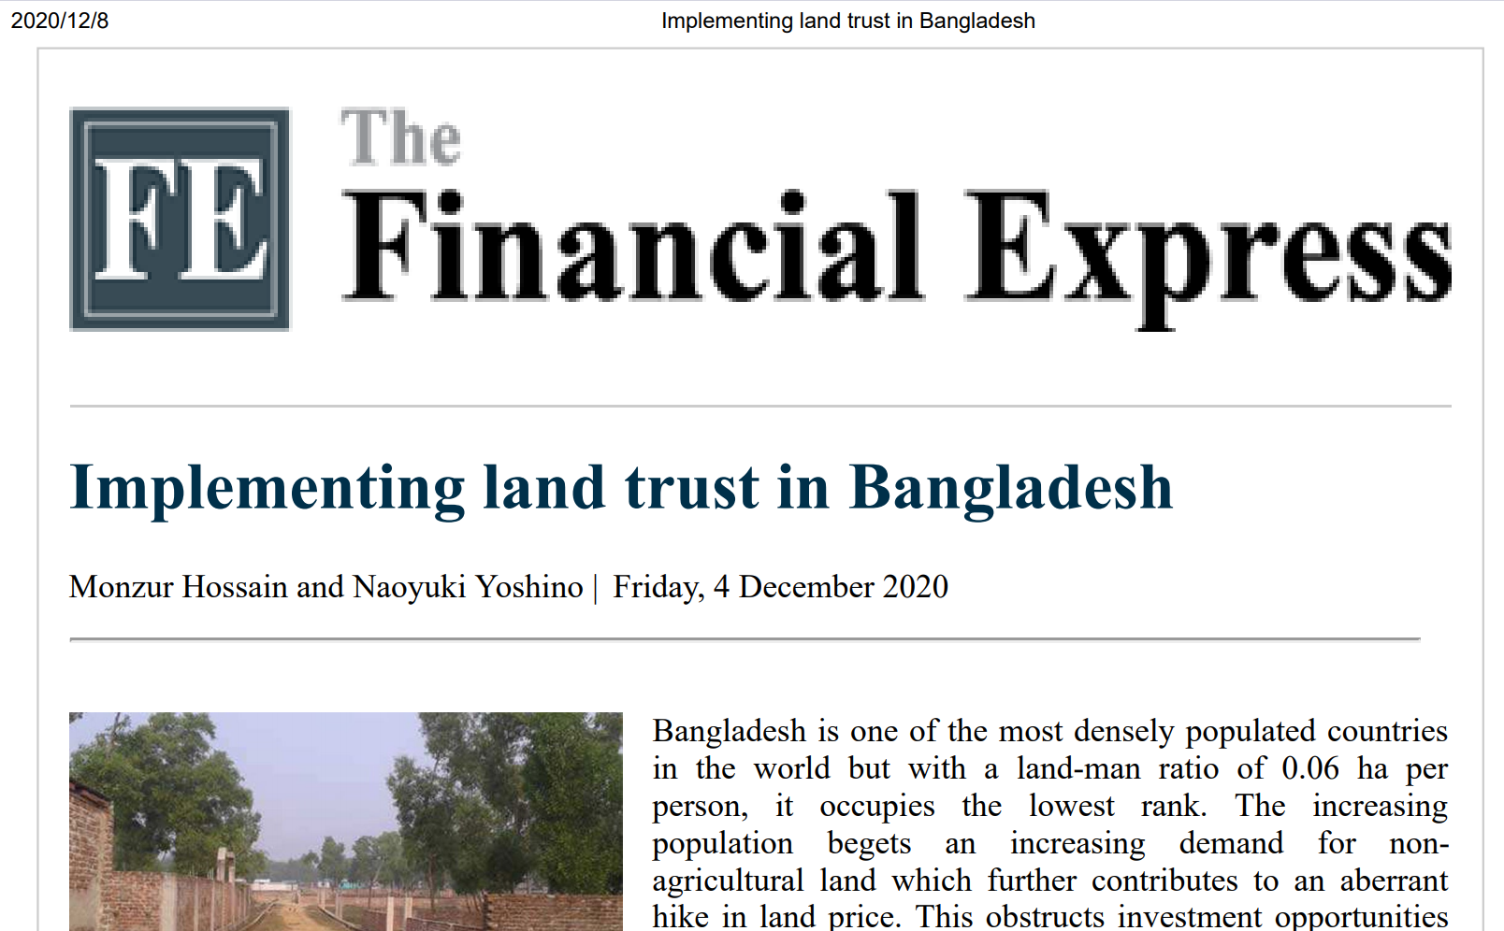

Slide 30
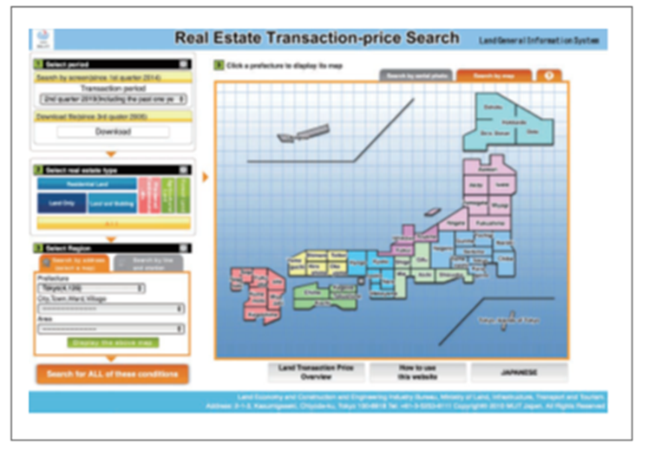

Slide 31
Infrastructure & Education
Yoshino and Umid Abidhadjaev (2016)
Dependent variable: log difference GDP per capita in 1991-2010
Regression number | REG.1 | REG.2 | REG.3
Variables | Coef. | Coef. | Coef.
lnY_1991 | -0.06 | -0.14 | -0.14
 | (-0.54) | (-1.35) | (-1.38)
ln(n+g+d) | -3.09 | -5.75 | -4.36
 | (-0.59) | (-1.23) | (-0.77)
ln(Kg) | 0.23 | 0.31 | 0.53
 | (1.17) | (2.00) | (3.30)
ln(Sec) |  |  | 0.00
 |  |  | (0.46)
ln(Kg)xln(Sec) | 0.20
 | (1.59)
ln(Uni) |  |  | 0.21
 |  |  | (2.07)
ln(Kg)xln(Uni) |  | 0.24
 |  | (2.76)
Constant | -0.28 | 0.56 | 0.48
 | (-0.33) | (0.69) | (0.57)
Number of observations | 44.00 | 44.00 | 44.00
R-squared | 0.21 | 0.30 | 0.30
F-statistic | 2.62 | 4.14 | 3.29
Countries
31

Slide 33
Environmental Issues
associated with Infrastructure
Y = F (L K_{P} K_{g} ) (1)
Traditional Production Function
F (Y, CO₂) = F (L K_{P} K_{g} ) (2)
Y= Output CO₂ emission
L= labor K_{P}= Private capital,
K_{g} =infrastructure

Slide 34
Thank you for your attention
Naoyuki YOSHINO
yoshino@econ.keio.ac.jp
Professor Emeritus of Keio University

Slide 35
Economic Effects of disaster
Effects on total GDP
L= Labor Agricultural sector
Kp = Private Capital Manufacturing sector
Kg = Infrastructure Services’ sector
d = Disaster
(GDP) Y = F (Kp, L, Kg, d)

Slide 36
Difference in difference estimation coefficients, million. JPY
Agricultural Region: Big Drop
It took 3 years for the recovery
Lehman Shock
Flood
－35％
Agriculture

Slide 37
Difference in difference estimation coefficients, million. JPY
Services sector : 4 years decline
Lehman Shock
Flood
-23%

Slide 38
Difference in difference estimation coefficients, million JPYen (Exports)
Only 1 year damage: Lehman was bigger
3 years
Lehman Shock
Manufacturing
Exports
Flood
Toyota city
－１３％

