Slide 1
Role of Postal Savings in Economic Development under Fintech age
Naoyuki YOSHINO
Professor Emeritus of Keio University
Director, Financial Research Center/ FSA/Government of JAPAN
Former Dean & CEO, Asian Development Bank Institute (ADBI)
yoshino@econ.keio.ac.jp

Slide 2
Sustainable Development Goals (SDGs)
1, Promotion of Domestic Savings
Bank deposits, Insurance, Mutual Funds
2, Mobilization of domestic savings into
domestic Investment
3, Infrastructure investment
4, Industrial development (SME)
5, Start up Finance
6, Human Capital Development (Education)
7, Proper tax system and fair tax collection
8, Anti corruption

Slide 3
Growing Savings Ratio in Asian Countries
1, Population Growth: Number of children, Population bonus
2, Income Growth, 3, Economic Growth
4, Government Support for pensions and un-employees
5, Financial Education 6, Children’ school Savings

Slide 4
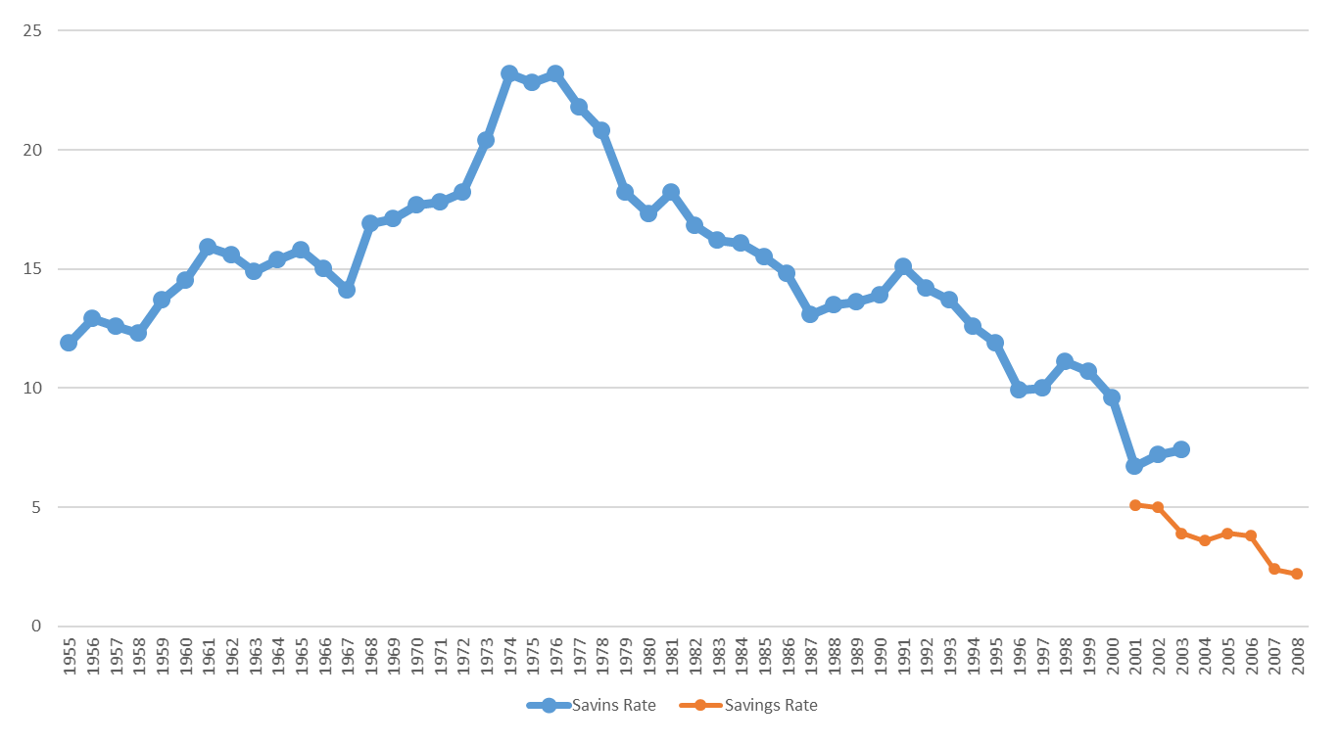
Households Savings Ratio Japan

Slide 5
Population Aging of Japan
Peak of the Population
2004, 127.8 million
10 of Thousands
Source：Ministry of Internal
Affairs and Communication
FY

Slide 6
History/projections of dependency ratio (age 65+/age 15-64)—highest in the Asian NIEs, followed by PRC and Thailand
Sources: World Population Prospects: The 2010 Revision of the United Nations Population Division, available at: http://data.un.org/Data.aspx?q=dependency+ratio&d=PopDiv&f=variableID%3a44 and Council for economic planning and development (Taipei,China), available at: http://www.cepd.gov.tw/encontent/m1.aspx?sNo=0001457, accessed 28.12.2012

Slide 7
Savings Ratio of Japan
1, Edo period (Samurai period, 1603-1868)
There were no custom to save for the future
2, Hisoka Maejima introduced Post office savings
3, Households’ savings rate were so low
4, Buddhist monk did not agree to promote savings
5, Children savings at primary school
6, Gradual increase of savings’ rate Japan
7, Recent trend of declining savings ratio
of Ageing population, Slower income growth
declining trend of number of children
8, Financial Technology -- Mobile banking
Collecting Deposits

Slide 8
Use of Postal Savings & Post Life Insurance
Government Banks
Loan to SME
Infrastructure
Housing
Postal Savings
Pension Funds
Ministry
Of
Finance
Postal Savings
Postal Life Insurance
Easy Access
24700 post offices, Japan
(Farmers and SMEs
were excluded)
Private
Financial
Institutions
Private Loans
Private Investment
Government
Bond
Government
Expenditures
Postal Savings
SME Loans
Infrastructure

Slide 11
Infrastructure

Slide 12


Crowding Out by Government Loans
Interest
Rate
Private
Bank
Loan
Supply
Government
Loan Supply
①
②

Slide 13
Complementary Loans (Crowding IN)
Interest
Rate
Private
Bank
Loan
Supply
Government
Loan Supply
Bank Loans

Slide 14
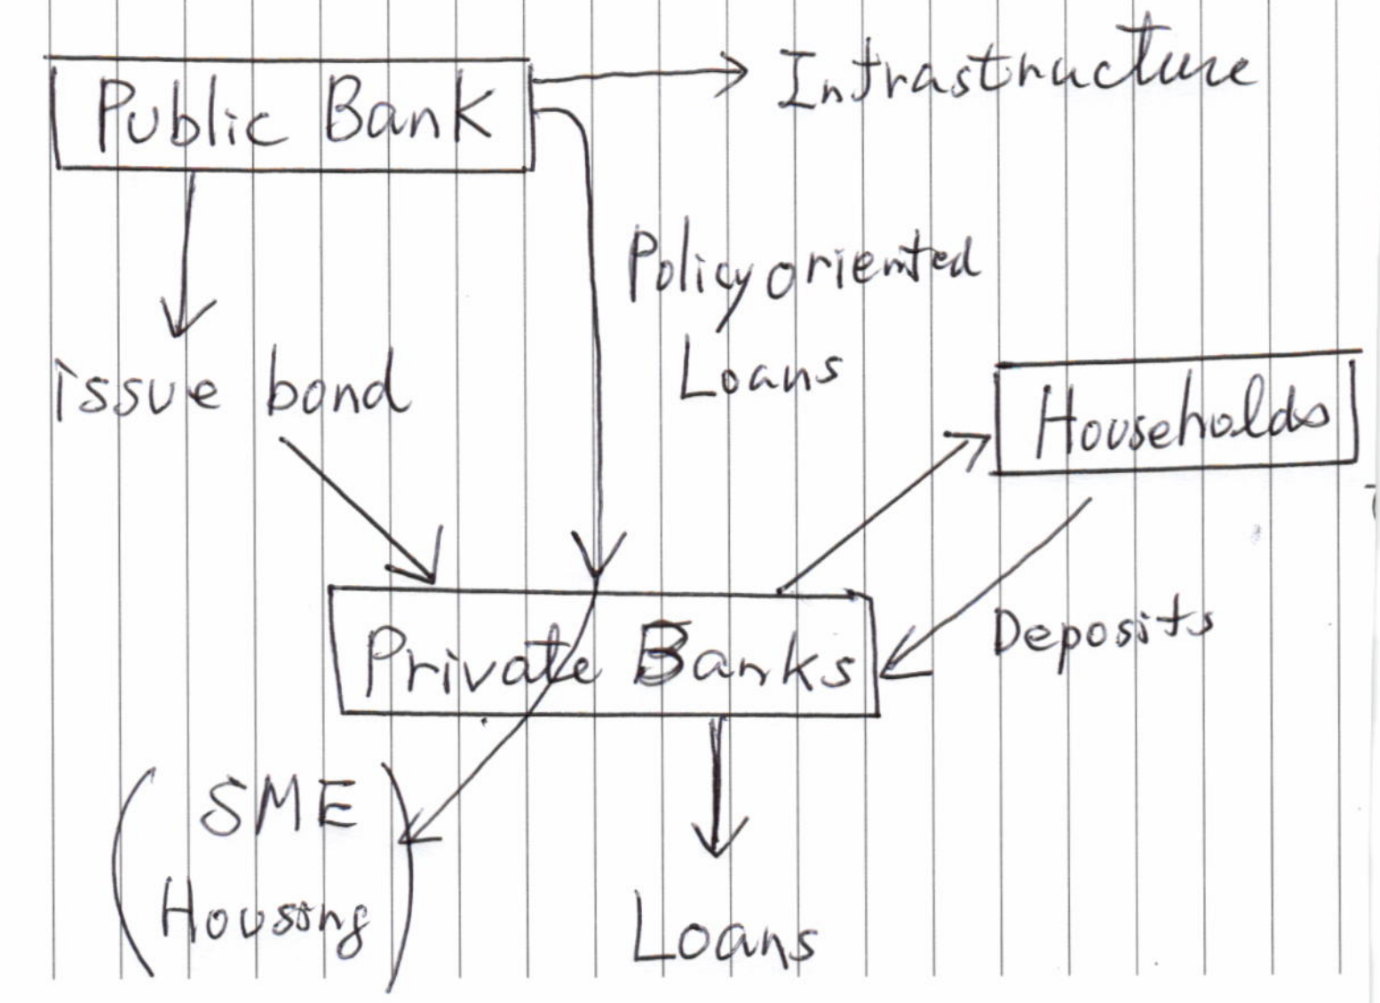

Slide 16
Development of Financial Technology
1, Access to financial products through mobile phone (Private Banks and Post office network)
2, Financial products can be supplied from overseas
Cross border Competition
3, Households can shop around various financial products through mobile phone
4, Easy for individuals to access to credit
Households’ Debt Overhang
5, Financial education will be very important

Slide 17
Fiscal Policy: Subsidies

Slide 18
Industrial Policy of Japan
Four Sectors
1, Coal Mining (Energy Sector)
2, Iron and Steel
3, Ship building
4, Sea Transportation

Slide 22
Cost Efficiency of Postal Savings in the Past
1, Scale Economy
Nationwide Post Offices, 24700 branches
2, Economies of Scope (German Post Bank)
(i) Mail Services
(ii) Postal Savings
(iii)Post Life Insurance (prepare retirement)
Financial inclusion of rural region
3, Reliability of Post Office Master
Post office master in Japan was respected.
4, Social Securities – Pay through post office
5, Easy Access to Post Office (No formal close)

Slide 23
Avoid Crowding Out of Private Loans
1, Avoid Bad Effects of Postal Savings
Increase of government role
Crowd out private deposits and loans
2, German KfW
→ Government money goes through
private banks
3, Make loans where
private banks cannot make loans

Slide 24
Post Office
1, Easy Access, Closeness, 24700 branches
2, Friendly, visit with casual clothes
3, Affordable transaction costs
4, Mobile postal service
5, Deposit Insurance (same with private deposits)
Inspection and Supervision (FSA, BOJ)
Capital requirement = different from Basel ?
6, Training of post office workers to handle
deposits starting at few post offices
7, Training of postal workers

Slide 25
Financial Education for SMEs
SMEs are working hard to make profits
they are experts in manufacturing, services, etc.
SMEs do not know how to manage assets
SMEs lose money by asset management
School education
Financial education for Adults
Financial education for Senior people

Slide 26
Fees and Commissions of Distributors
Maximize Fee and Commissions (Distributors)
Investors --- maximize Return
Trust Fees & Commissions= α（A＋Dividend)
Trust Fees and
Commissions
MAX Return
Households
Distri-butors
Banks
Securities companies
Asset Management
Company

Slide 27
Future of Postal Savings in Fintech age
1, Nationwide Access to everybody (Postal S)
→ Fintech can improve accessibility
2, Would everybody open their accounts ?
3, higher fees for small savers ?
4, Would postal savings be sustainable ?
Serving for everybody (higher costs)
5, Sales of Mutual funds at Post office
6, Public ownership vs Private ownership
7, Technologically adapted postal savings

